Slide 1


PUOKHU VATSHA 9.6 BVU
KETHOLESHIIDA… DIETHERIEKO
Ketholeshiida … Dietherieko kezhakesu, Kijiipete Krothoko Fort Worth, Texas
©2006 TBBMI
Designed by Dr. John Fryman, Texas, USA • BibleBasically.org
Taught by Dr. Rick Griffith, Singapore Bible College
All files in many languages for free download at BibleStudyDownloads.org
www.biblebasically.com
©2006 TBBMI

Slide 2


(Thedzeko puo kele therieko zo)
Ketholeshü puo sede kemeyie
®
Za thetha
Leshüdau chü separ kelie
Ketholeshü kesau se vor kesakelie
9.65.08.
©2006 TBBMI
02
Notes:
Remembering that the Biblical story line is still the basic idea…
we move now to the second part of SETTING UP THE BOOKS…
where the “NEW” Testament comes together

Slide 3
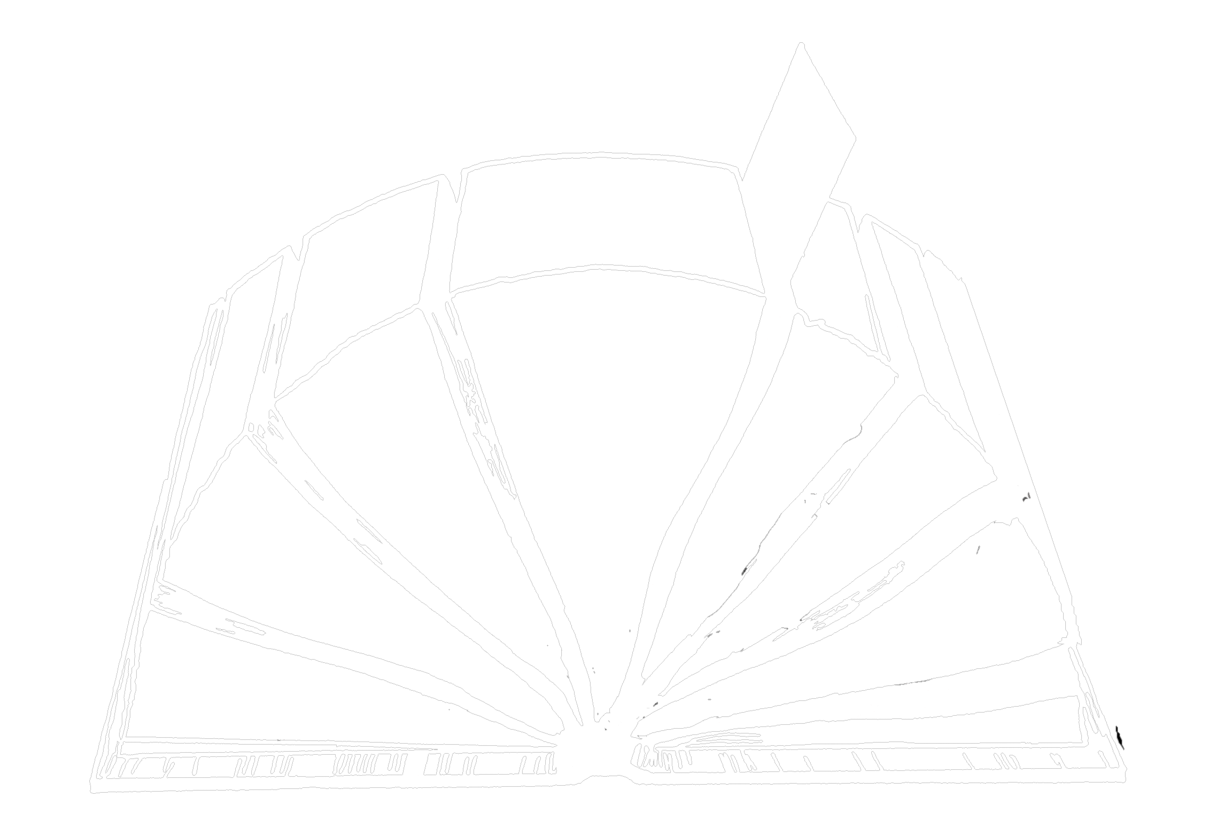
4
3
5
6
2
Dieliekevi
Sedzekesi die
Mhakechüko
khuthuko
7
Themia kelhoudze
Apostelko kethu
1
thezho
Pesikeshü
8
Ketholeshii kehiepiekezhiiu
03
Notes:
Here are The New Testament's 27 books….the other half of that Opened Bible graphic we worked with earlier.

Slide 4
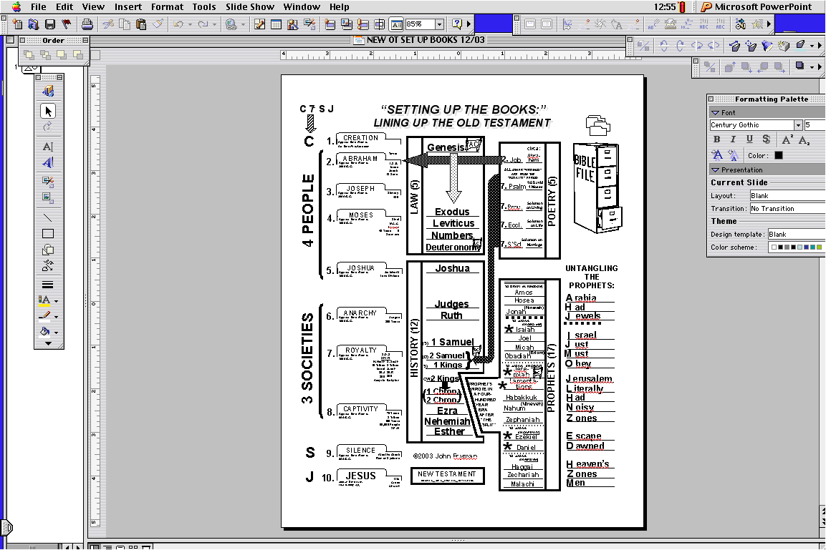
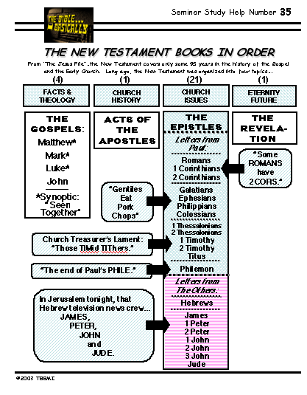
“Ketholeshü kehiepiekezhü u”
Leshüda mepfüethepfhüko
YOUR STUDY GUIDE
Ketholeshü kesau
Nahum
04
1
Notes:
Here again is the Old Testament Study Help #19 and #34 we just finished.
//// And you'll quickly see that the New Testament Study Help looks quite different. But it, too, is organized into four divisions – according to the right side of that “OPENED BIBLE” study help – just as the Old Testament study help completed before matched those on the left side of the “OPENED BIBLE” graphic.

Slide 5
STUDY HELP #20
Dielekevi
Mhakechüko
Apostelko kethu
Pesikeshü
05
Notes:
So…using Study Help #20 as your worksheet, let's look at it closely as “THE NEW TESTAMENT COMES TOGETHER.”
//// We begin on the left with THE FACTS AND THEOLOGICAL FOUNDATIONS…these are THE GOSPELS. We'll fill in the blanks on the Study Guide as we go forward.

Slide 6
Dieliekevi
Mhakechüko
Apostelko kethu
Pesikeshü
06
Notes:
The next column presents CHURCH HISTORY…THE ACTS OF THE APOSTLES.

Slide 7
Dieliekevi
Mhakechüko
Apostelko kethu
Pesikeshü
07
Notes:
Then on to CHURCH ISSUES…these are THE EPISTLES or letters of
the early church.

Slide 8
Dieliekevi
Mhakechüko
Apostelko kethu
Pesikeshü
08
Notes:
And finally that glimpse into eternity future…presented in THE REVELATION. Imagine it as one bookend to Scripture that matches the first twelve chapters of Genesis in the Bible's beginning pages, the other bookend that we talked about earlier.

Slide 9
Dieliekevi
Mhakechüko
Apostelko kethu
Pesikeshü
09
Notes:
Here is the complete Study Guide...the Gospels…the Acts…the Epistles…and the Revelation..as it will appear when we finish unpacking it. So...let's begin.

Slide 10
Ketholeshü Keweu: 1,500 YEARS
Ketholeshü Keweu: 40-50 YEARS
4
3
5
6
2
Dieliekevi
Sedzekesi die
Mhakechüko
khuthuko
7
Themia kelhou dze
Apostelko kethu
1
THEZHO
Pesikeshü
8
Ketholeshü thuketuo la puotei lie ta ketuo
10
1
Notes:
To frame this study...think about this...the Old Testament required some 1,500 years for writing its 39 books...but, interestingly…
//// …the New Testament extends through only about 100 years of its own and the world's history. But for the actual writing of its 27 books, only some 40-50 years. Once again...we'll be placing these books in a broader context of meaning and application.

Slide 11
Ketholeshü kesau kho dia chükeshü:
A.D. 40s mu 90s doki thukeshü
(leshüda dia)
(leshüda puo)
(leshüda mepfüepuo)
(leshüda puo)
Kethoko mu Nounyü dze keprhü
Kehou dzeüse ko
Kehou nu Nyieko
Kechachie kelhou mu vor ketuoko
DIELIEKEVI
Apostelko
mhatho
Apostelko kethu
Pesikeshü
11
6
Notes:
Here are the four large traditional organizational sections of THE NEW TESTAMENT.
//// This is the place in THE BIBLE…BASICALLY where “The New Testament Comes Together.”
//// First, THE GOSPELS...laying out the basic facts and theology of the New Testament era. In parenthesis: you'll see that there are FOUR books involved here.
//// Second, THE ACTS OF THE APOSTLES...this is church history at its very foundation stones...how the Gospel was spread through much of the Ancient Near East and its introduction into Europe and Asia. Note that only ONE book comprises the Acts of the Apostles.
//// Third, THE EPISTLES...as we said…these are letters, sometimes simple person-to-person writings, and sometimes grand and complex explanations and expositions of the new Christian theology. They address an enormous array of NEW TESTAMENT issues...circumstances that no man had ever faced before, simply because the Church was a totally new organization...an organism, really...newly introduced into the life of the planet. Paul the Apostle calls it, formerly, a mystery. The number of Epistles: TWENTY-ONE different letters to various audiences on a variety of theological and personal subjects.
//// And fourth, THE REVELATION...that intriguing glance into Eternity Future where all of earth's history approaches its climax, revealing the Father's Plan for man's final redemption, first played out and begun through old Abraham, extending through the ministry of the Messiah in ancient Israel, and reaching its culmination with His return in the problematic End Times. This is pure prophecy.
Number of books, only ONE; remarkable when we compare it with almost two dozen books of prophecy in the Old Testament.
//// All of these books were written somewhere across the A.D. 40s to the 90s.

Slide 12
(leshüda die diako)
Kethoko mu nounyüdze kephrü
DIELIEKEVI:
(leshüda dia)
Kethoko mu nounyü dze ke phrü
Mathi*
Mark*
Luk*
Johan
Dieliekevi
*Synoptic:
“die puoca kemhie
keba”
12
3
Notes:
The first section of the New Testament: THE GOSPELS...THE FACTS AND THE THEOLOGY, clearly set out in four books, all of which form the framework for all the rest of the New Testament – and the future of the Church and of all Christianity for all time…for that matter!
//// Here they are, in four books: MATTHEW, MARK, LUKE and JOHN. These are THE GOSPELS, the Good News of the Ministry of the Lord Jesus Christ.
//// Notice that the first three Gospels –– MATTHEW, MARK, AND LUKE –– each have an asterisk by their names.
//// These books are gathered into a special sub-group we call SYNOPTIC...a word meaning “to see together”...in that the text of these books view the ministry of Jesus Christ from a special perspective that differs from that of the Gospel of John. Let's talk about that

Slide 13



“Niepuu Jisu Khrista kelhou rhiu chii tseikeshü”
51a
Ketholeshü puo sede kemeyieko;pedesüchü nunu
Puocha kekreikecü dia nunu mehokeshü
STUDY HELP #21
13
2
Notes:
Using Study Help #21, through this large picture frame…
we're going to create a graphic representation called
//// A FINISHED PORTRAIT OF THE LORD JESUS CHRIST… but…
//// …we're going to compose that portrait through four different literary lenses as the completed image develops.

Slide 14
Dieliekevi thukeshükoe:
51a
Puothuo puo kemeho ko kreitou
•Jisu Khrista puorhei pekreise di themia kie
• Dieliekeviu thuketuo la rhükelie mvüdzeu
Puothuo thuketuo teisozhau
14
4
Notes:
From each Gospel writer…
//// …we'll discover the specific audience for his writings…
//// …with his unique presentation of the person of Jesus Christ…
//// …suggesting a foundational purpose communicated through the text of his Gospel…
//// …followed by the scholars' estimate of the date of each writing.

Slide 15
Themia dia kelhou rhiu……
51a
1
2
3
4
15
Notes:
Now, please…in your imagination…insert four smaller picture frames into the larger one. In each frame install four lines. As we fill them in we'll have some specific information about the purpose and function of each of the four Gospels. The individual “sub-frames” are designated 1 through 4.

Slide 16
Dieliekeviko rhiu......
51a
1
MATHI
2
MARK
3
LUK
4
JOHAN
16
3
Notes:
Each of the frames now gets its name... MATTHEW in the first...
//// MARK, second...
//// LUKE, third...and finally, the fourth…
//// JOHN, the names of the Gospels in the order of their appearance in the New Testament canon...the official collection of Biblical writings.

Slide 17
Dieliekeviu kemehomiako….
51a
1
MATHI
2
MARK
TO:
JUDAMIA
TO:
ROMIAKO
3
LUK
4
JOHAN
TO:
GRIKMIA
TO:
KEHOUKI
17
4
Notes:
Now comes an idea endorsed by Biblical scholars around the world…having to do with the audiences TO WHICH each Gospel was written.
For instance…
//// MATTHEW penned his work specifically toward his brothers and sisters in the Jewish audience. He makes repeated references to a regnant Jesus, seeing him as the Messiah and the King of the Chosen People.
//// For MARK, his work is widely regarded as directed toward the Romans, then occupying his native land and into the farther parts of the ancient world. MARK is brief, to the point. And, in fact, repeatedly he uses such term as "straightway" in early translations…all in a get-the-job-done mentality, which characterized the Roman way of thinking and doing things.
//// While LUKE, the physician, is the highly intellectual Greek who accompanied Paul on his tours. For LUKE, his Gospel audience was the Greeks, and in other words, to the Gentile world in general.
Also as the author of The Acts, Luke set down for all time a detailed account of the development of the early church and its wide-spread missionary ministries, to which he was a witness.
//// Finally, we come to the gospel of JOHN, whose audience differs markedly from the first three. John is written directly to UNBELIEVERS, AND REACHING THEM THROUGH THE COMMUNICATION CHANNEL OF THAT NEW ORGANISM, THE CHURCH. In fact, when you read John's gospel, you are struck with the fact that his work carries with it a somewhat mystical quality, certainly not the quick, even terse recounting of facts as we find in Mark's Gospel. John's audience –– the Church itself, the members of the new Organism, bathed in the redemptive love of Christ –– receives his brilliant articulation of the impact of the coming of the Holy Spirit, now –after the Day of Pentecost -- having taken up permanent residence in the heart of each new believer.
So there are four individual audiences to which the Gospels were specifically directed at the time of their writing. That one insight, alone, gives a new way to categorize and individualize the Gospel writings.

Slide 18
Jisu rhiu se
51a
2
1
2
1
MATHI
MARK
TO:
JUDAMIA
TO:
ROMIAKO
AS:
KEDI-U
AS:
KITUOMIA
AS :
4
3
4
3
JOHAN
LUK
JOHN
GRIKMIA
KEHOUKI
TO:
TO:
CHURCH
TO:
TO:
AS:
Ukepenuopfü/Themia
Ukepenuopfü
18
4
Notes:
Another question: How does each Gospel portray The Lord as a Man and as Immanuel, “God With Us?”
//// For MATTHEW...Christ is seen as King of the Jews. Repeatedly Matthew describes how Jesus is the fulfillment of Old Testament Scripture. Matthew makes wide use of Jewish terminology of royalty.
//// For MARK...He is seen as the Servant of all...some say the Suffering Servant, and traditionally associated with an audience in Rome and among the widespread Roman world.
//// LUKE sees Christ as the God-Man -- truly God and truly Man. Luke shows the Gentiles that Christ is the perfect man to which they aspired.
//// Finally, John's Gospel. Clearly and above all else...JOHN portrays Christ as God Himself. JOHN uses his pen to communicate the mystery and the power of the Messiah. Why? Because John experienced a particular closeness to the Master, one that was apparently unique among the disciples. Remember too that this was this same JOHN who was destined to see and write down the great End-Times vision we know as The Revelation.

Slide 19
THE MESSAGE IN A NUTSHELL…
51a
1
MATHI
2
MARK
TO:
JUDAMIA
TO:
ROMANS
AS:
KEDIU
AS:
KITUOMIA
Puo pu Keshüko
Puo Chükeshüko
3
LUK
4
JOHAN
TO:
GRiKmia
TO:
KEHOU
Ukepenuopfii/
themia
Ukepenuopfü
AS:
AS:
Puo le kecüu
PUO LE KEBAU
19
5
Notes:
Here is a last set of interesting ideas, with thanks to some anonymous believer who developed them years ago.
//// Call it “the message in a nutshell.” Question: what is the one single word that might characterize the message of each Gospel?
//// For MATTHEW...that book tells us what Jesus Christ SAID.
//// MARK tells us what He DID.
//// LUKE shows us clearly what the Messiah FELT.
//// And JOHN, with enormous clarity, tells us what Christ MEANT!
What he SAID...what He DID...what He FELT...and what He MEANT!
These single-word ideas help us to tightly focus on the remarkable differences that exist among the Gospel writings. For many Bible readers, such distinctives are unfamiliar territory.

Slide 20
KETHEKHRii KECii DIEU…..
51a
SYNOPTIC:
MATHI
MARK
TO:
JUDAMIA
TO:
ROMANS
AS:
KEDIU
AS:
KITUOMIA
Puo pu Keshüko
Puo Chükeshüko
SYNOPTIC:
“Die puoca kemhie keba”
“meho kesakeshü”
LUK
TO:
GRiKmia
Ukepenuopfii/
themia
AS:
Puo le kecüu
20
3
Notes:
Now comes that word that's a strange one to many...
//// SYNOPTIC…meaning…
//// … “TO SEE TOGETHER”…add these words to that triangle shape on your study help.
//// It is a term from Greek roots that means seeing a group of things together... from the same general perspective. One word that, again, helps organize and categorize the enormous factual base that makes up our Bible.

Slide 21
THE SYNOPTICS: “MEHO KESAKESHü”
51a
1
MATHI
2
MARK
TO:
JUDAMIA
TO:
ROMIAKO
AS:
KEDI-U
AS:
KITUOMIA
PUO PU KESHIIKO
Puo chükeshüko
∑
3
LUK
4
JOHAN
TO:
GRIKMIA
TO:
KEHOU
Ukepenuopfü/ themia
Puo le kecüu
Ukepenuopfü
AS:
AS:
PUO LE KEBAU
21
1
Notes:
Follow the arrows as they link together the gospels of MATTHEW, MARK and LUKE. Again…you'll notice that JOHN is not among them. Those three are the so-called SYNOPTIC Gospels...THEY ARE SEEN TOGETHER...in that these works take on that ground-level view of the human history of Jesus Christ just as he walked about Palestine in the days of his ministry. The Man…and his Mission among his People.
//// On the other hand…the Gospel of John –– seen here with the familiar mathematical SUMMA sign –– represents the summation of all that Jesus Christ MEANT –– the sum of all that he preached and demonstrated –– both publicly and privately. Seeing the Lord clearly as God Himself, John raises our spiritual horizon in ways that the first three gospels do not.

Slide 22
JOHAN: PUO DIEYIE THELA CHiiWA KETUO
51a
1
MATTHEW
2
MARK
TO:
JEWS
TO:
ROMANS
AS:
KING
AS:
SERVANT
WHAT
HE:
SAID
∑
WHAT
HE:
DID
3
LUKE
4
JOHAN
TO:
GREEKS
TO:
KEHOUKI
GOD/MAN
Ukepenuopfü
AS:
AS:
WHAT
HE:
FELT
PUO LE KEBAU
22
Notes:
So, in summation, then…John wrote to UNBELIEVERS THROUGH THAT NEW ORGANISM, THE CHURCH, envisioning Christ as God Himself…
But what did John SAY that Jesus meant in his preaching?

Slide 23
6 GREAT TRUTHS
STUDY HELP #22
JOHN: SUMMING UP THE MESSAGE
Thuthie puo: Jisu Khrista dietho kemeyie sorouko
JISU KHRISTA!
Khusokhu puo:
sietsenu ketuou
Meciimecie kecii kelhou
Puo Ukepenuopfii zo
"In the beginning was the Word, and the Word was with God, and the Word was God."
23
3
Notes:
John's first chapter sums up his message about Christ. Follow along with Study Help #22. John 1:1-9 has:
//// SIX GREAT TRUTHS of Jesus Christ. John lists them.
//// Verse One: He is portrayed as the Pre-existent One, a Distinct Person, but Who WAS and IS God.
//// Verse One reads: “In the beginning was the Word, and the Word was with God, and the Word was God.”

Slide 24
John 1:2
JOHAN:PUO DIEYIE THELA CHüWAKETUO
Thuthie puo: Jisu Khrista dietho kemeyie sorouko
JISU KHRISTA!
Khusokhu puo:
setse nu ketuou
Mecümecie kecü kelhou
Puo Ukepenuopfü zo
Khusokhu kenieu:
kechachie rhiketuou
“thrietho nunu puo-e Ukepenuopfü zetuo.”
24
1
Notes:
Verse 2: He is Eternally co-existent in that…
//// “He was with God in the Beginning.”

Slide 25
John 1:3
JOHAN:PUO DIEYIE THELA CHüWA KETUO
Thuthie Puo: Jisu Khrista dietho kemeyie sorouko
Khusokhu puo:
setsenu ketuou
Mecümecie kecü kelhou
Puo Ukepenuopfü zo
JISU KHRISTA!
Khusokhu kenie
kechachie rhiketuou
“Puo geinu mha pete chülie mu chü kelieko puorei Puo sa modi chü mo.”
Khusokhu se
Kijii chiikeshiiu
25
1
Notes:
Verse 3: He is the Creator of the Universe…
//// “Through him all things were made; without him nothing was made that has been made.”

Slide 26
John 1:4, 5, 9
JOHAN:PUO DIEYIE THELA CHüWA KETUO
Thuthie puo: Jisu Khrista diethi kemeyie sorouko
Khusokhu puo:
setse nu ketuou
Mecümecie kecü kelhou
Puo Ukepenuopfü zo
JISU KHRISTA!
Khusokhu kenie:
kechachie rhiketuou
“Puo gei kerhei tuo, mu kerheiro siiu themia pete kezieu zo.kezieu kezei va pezie tuoya mu kezeiu süu soulie mo....kezie ketho süu mia pete va pezietuoü kijü nu vor.”
Khusokhu se:
kijü chükeshü u
Khusokhu dia,pengou,thepfü:
kezie mu kelhou pete Puo geinu vor
26
1
Notes:
And finally…verses 4, 5, and 9…the Source of all Light and Life…
//// “In him was life, and that life was the light of men. The light shines in the darkness, but the darkness has not understood it…The true light that gives light to every man was coming into the world.”
THIS IS BASIC CHRISTIAN THEOLOGY. IT ALL STARTS HERE!

Slide 27
…thukelie teisozhako?
1
MATHI
2
MARK
The A.D.40s
A.D. 64-68
TO:
JUDAMIA
TO:
ROMANS
AS:
KEDIU
AS:
KITUOMIA
Puo pu Keshüko
Puo Chükeshüko
3
LUK
4
JOHAN
A.D. 57-59
A.D. 69 mechii-u mhingu chiikewa shie
TO:
GRiKmia
TO:
KEHOU
Ukepenuopfii/
themia
Ukepenuopfü
AS:
AS:
Puo le kecüu
PUO LE KEBAU
27
4
Notes:
Now…what about the dates of the writing of these crucial documents? And here we are left to our best scholarly guesses. There will ALWAYS be argument here. But some of the best guesses, based on decades of academic research and study are these – in suggested order…
//// MATTHEW…composed sometime during the A.D. 40s…
//// LUKE is suggested as next, between the years A.D. 57 and 59 A.D…
//// Mark…in the next decade…between 64 and 68…
//// and finally…John's Gospel…around A.D. 69….but certainly after the Synoptics were set down. Again, you will always find disagreement on these dates. However, these dates are from the research of well-known Christian scholars and teachers.

Slide 28
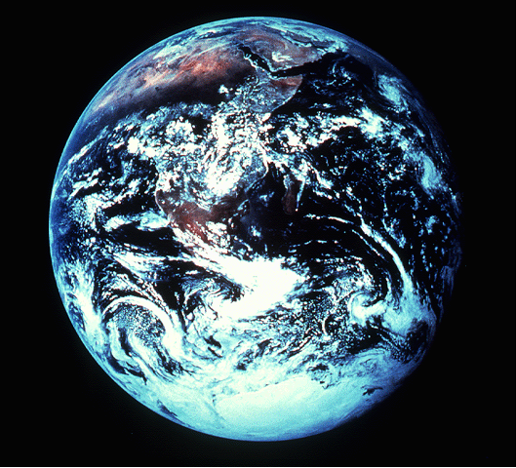
Kelhou rhi chii tseishü ketuo la…
1:12-18 (NIV)
¹²I turned around to see the voice that was speaking to me. And when I turned I saw seven golden lamp stands,
JISU KHRISTA APOSTEL JOHAN KI PESIKESHü DIE
MATTHEW
MARK
¹³and among the lamp stands was someone "like a son of man,” dressed in a robe reaching down to his feet and with a golden sash around his chest.
¹⁴His head and hair were white like wool, as white as snow, and his eyes were like blazing fire.
¹⁵His feet were like bronze glowing in a furnace, and his voice was like the sound of rushing waters.
¹ ¹⁶In his right hand he held seven stars, and out of his mouth came a sharp double-edged sword. His face was like the sun shining in all its brilliance.
¹⁷When I saw him, I fell at his feet as though dead. Then he placed his right hand on me and said: "Do not be afraid. I am the First and the Last.
LUKE
JOHN
¹⁸I am the Living One; I was dead, and behold I am alive for ever and ever! And I hold the keys of death and Hades.”
28
9
Notes:
Now…to complete the portraits given to us by
MATTHEW…MARK…LUKE…and JOHN.
//// For this, we need to get out into space and look at this unfortunate planet. Man has made a mess of it, you will probably agree. This view of earth helps us more clearly understand the final view of Christ given to us in the New Testament.
//// Now travel to the last book of the New Testament…The Revelation of Jesus Christ to John the Apostle. There, we see Jesus Christ in His risen, ascended glory, as he will appear when He returns at the end of History to reclaim all that is His.
//// In his first chapter of The Revelation, John writes this:
I turned around to see the voice that was speaking to me. And when I turned I saw seven golden lamp stands…
//// and among the lamp stands was someone “like a son of man,” dressed in a robe reaching down to his feet and with a golden sash around his chest.
//// His head and hair were white like wool, as white as snow, and his eyes were like blazing fire.
//// His feet were like bronze glowing in a furnace, and his voice was like the sound of rushing waters.
//// In his right hand he held seven starts, and out of his mouth came a sharp double-edged sword. His face was like the sun shining in all its brilliance.
//// When I saw him, I fell at his feet as though dead. Then he placed his right hand on me and said: “Do not be afraid. I am the First and the Last.
//// I am the Living one; I was dead, and behold I am alive forever and ever! And I hold the keys the death and Hades.

Slide 29

Niepuu Jisu Khrista kelhou rhiu chii tsikeshii
“…mu themia pete bu n geinu theja pfiituo.” keriekitho 12:3b
29
1
Notes:
With this FINISHED PORTRAIT OF THE LORD JESUS CHRIST we now have a more secure handle on the four Gospels as the beginning documentation of the New Testament -- out of which every succeeding New Testament idea and historical event unfolds.
…And we can see once again the enormous importance of the
Abrahamic Covenant promises…especially Genesis 12:3. Remember that ancient promise to Abraham.
//// God promised the Hebrew patriarch that “I will bless those who bless you, and whoever curses you I will curse…AND ALL PEOPLES ON EARTH WILL BE BLESSED THROUGH YOU.” That blessing was realized in the Messiah's glorious advent into the earth. Now let's go along farther.

Slide 30
KETHOLESHii KESAU KEZA DIA CHiiKESHii:
A.D. 50s MU 90s DOKI THUKELIE
(leshiida dia)
(leshiida puo)
(leshiida mepfiiepuo)
(leshiida puo)
Kethoko mu nounyii dze kephrii
Kehou dzeiise ko
Kehou nu nyieko
Kechachie kelhou mu vor ketuoko
DIELIEKEVI
Apostelko mhatho
Apostelko kethu
PESIKESHii
30
Notes:
Now we come to a single remarkable recounting of the history of the early church and the opening of the concept of “mission”...that single book known as THE ACTS OF THE APOSTLES.

Slide 31
MHATHO Chü KHREKELIE DZEKO
THEMIA KEMEYIEKO:
Thukeshu-u Dr. Luke thelatsa A.D. 50s
(khusokhu puo)
• Paul
• Peter
• Barnabas
• John Mark
• Timothy
• Philip
• Luke (The Author)
Kehou dzeiise ko
Apostelko mhatho
31
8
Notes:
As a history of the resulting events…..THE ACTS almost certainly were written by Dr. Luke. It gives us vital detail of the lives of those who experienced that early history…
//// …thorough the lives of its major characters,
//// Paul,
//// Peter,
//// Barnabas,
//// young John Mark,
//// Timothy,
//// Philip,
//// And Dr. Luke…the Author Himself, and a cast of other
characters moving in and out of the story…a work almost certainly written during the late A.D. 50s, all First Century events. Scholars tell us that, given the enormous store of detail and coincident events checked by secular sources, the book of Acts has that ring of absolute truth. Events that really happened. Characters who really lived. To read of their lives and their progress in Christian growth –– especially in missions –– is to deliver to us lessons of incredible spiritual value and encouragement….not to mention operational strategies.

Slide 32
1
2
3
4
5
6
7
Jesus' Commission and Ascension
Pentecost: The Birthday of the Church
A Lame Man Healed
The First Persecution
Ananias and Sapphira
The First Deacons
Stephen and Martyrdom
UKO MHA SüKO LA KEDIPUO CHüSHü BAGA?
JERUSALEM NU Chs. 1-7
AN AGELESS DRAMA IN THREE EPISODES!
THE CHURCH IS BORN… AND HERE WE ARE!
AN AGELESS DRAMA IN THREE EPISODES!
THE CHURCH IS BORN… AND HERE WE ARE!
”…and you will be my witnesses in Jerusalem, and in all Judea, and Samaria, and to the ends of the earth.” Acts 1:8b
”…and you will be my witnesses in Jerusalem, and in all Judea, and Samaria, and to the ends of the earth.” Acts 1:8b
STUDY HELP #23
Phillip and the Eunuch
Saul's Conversion: the Damascus Road
Peter and Cornelius
Peter Vindicates the Gentile Ministry
Herod Persecutes the Christians
PALESTINE MU SYRIA NU
Chs. 8-12
8
9
10
11
12
AN INDEX TO THE ACTS OF THE APOSTLES
13
14
15
16
17
18
19
20
21
22
23
24
25
26
27
28
THE FIRST MISSIONARY JOURNEY
“
THE JERUSALEM COUNCIL
THE SECOND MISSIONARY JOURNEY
“
“
THE THIRD MISSIONARY JOURNEY
“
Paul: In Jerusalem
Paul: Defense Before the Multitudes
Paul: Defense Before The Sanhedrin
Paul: Defense Before Felix
Paul: Defense Before Festus
Paul: Defense Before King Agrippa
THE VOYAGE TO ROME: Shipwreck
Paul in Rome
KIJU NU
Chs. 13-28
©2006 TBBMI
32
5
Notes:
And the Program continues as the Church begins to spread. Study Help #23 lists an index to those glorious adventures in The Acts of the Apostles. Its 28 dramatic chapters clearly divide its progress…
//// Chapters 1 through 7, set in Jerusalem, begin with Jesus' further Commission to spread the Gospel through witnessing to his ministry “in Jerusalem, and in all Judea, and Samaria, and to the ends of the earth.”
//// Chapters 8 through 12 expand the cast to include Philip, Paul and Peter. Persecution occurs and the church begins to move out into the surrounding regions and provinces…Palestine and Syria!
//// AND INTO THE WORLD! The remainder of the book –– Chapters 13 through 28 –– establishes THE MISSIONARY AGENDA of the early church. Paul is the central character as he expands the Gospel throughout the Mediterranean Basin. He is required to make studied responses to many of the leaders and thinkers of his day, ending in his final voyage to Rome where his courageous ministry ends.
//// Through its 28 chapters…THE ACTS presents an ageless drama in three episodes. The church is born in these pages…and here YOU AND I ARE LEFT TO CONTINUE THE WORK!
//// So the question remains: WHAT ARE WE DOING ABOUT IT? And the story moves on…

Slide 33
KETHOLESHü KEZA DIA CHüKESHü:
A.D. 50s AND 90s DOKI THUKELIE
(leshüda puo)
(leshüda puo)
(leshüda mepfiiepuo)
(leshüda puo)
Kethoko mu nanyü dze kephrii
Kehou dzeiise ko
Kehou nu nyieko
Kechachie kelhou mu vorketuoko
DIELIEKEVI
Apostelko mhatho
Apostelko kethu
pesikeshü
33
Notes:
For that new organism, the Church, enormous unexpected and troubling issues emerged among the widespread congregations –– between the people themselves and also concerning their worship of the Lord. For those reasons, in the absence of printing, it was necessary to circulate instructive letters from the church leaders. They were known then and now as THE EPISTLES.

Slide 34
PAUL RüVEKO Chü KEMEZHü KESHü
Kijü miarhi nie Bible thelatsa rhipie kezüu...kethu pie keba ko... Rhiephi,rhiepie kebako...puocha rhie kemezhü pie kebako.... Kemerü kecü puocha rhiepie keba mu puozie kekreikrei kecüko, puorie puo mhogei khune chüpie keba ngulie!
34
1
Notes:
One way to frame these problems and to appreciate the daunting challenge of the task of missions –– then and now –– is to appreciate and to straighten out Paul's wide travels! For most people…Paul's trips have always been – to say the least – geographically confusing!
//// You know that map in the back of your Bible…the one with all the dotted lines…the dashed lines…straight lines…lines with little circles…lines of different colors…and often all of them PRINTED ON TOP OF EACH OTHER.

Slide 35
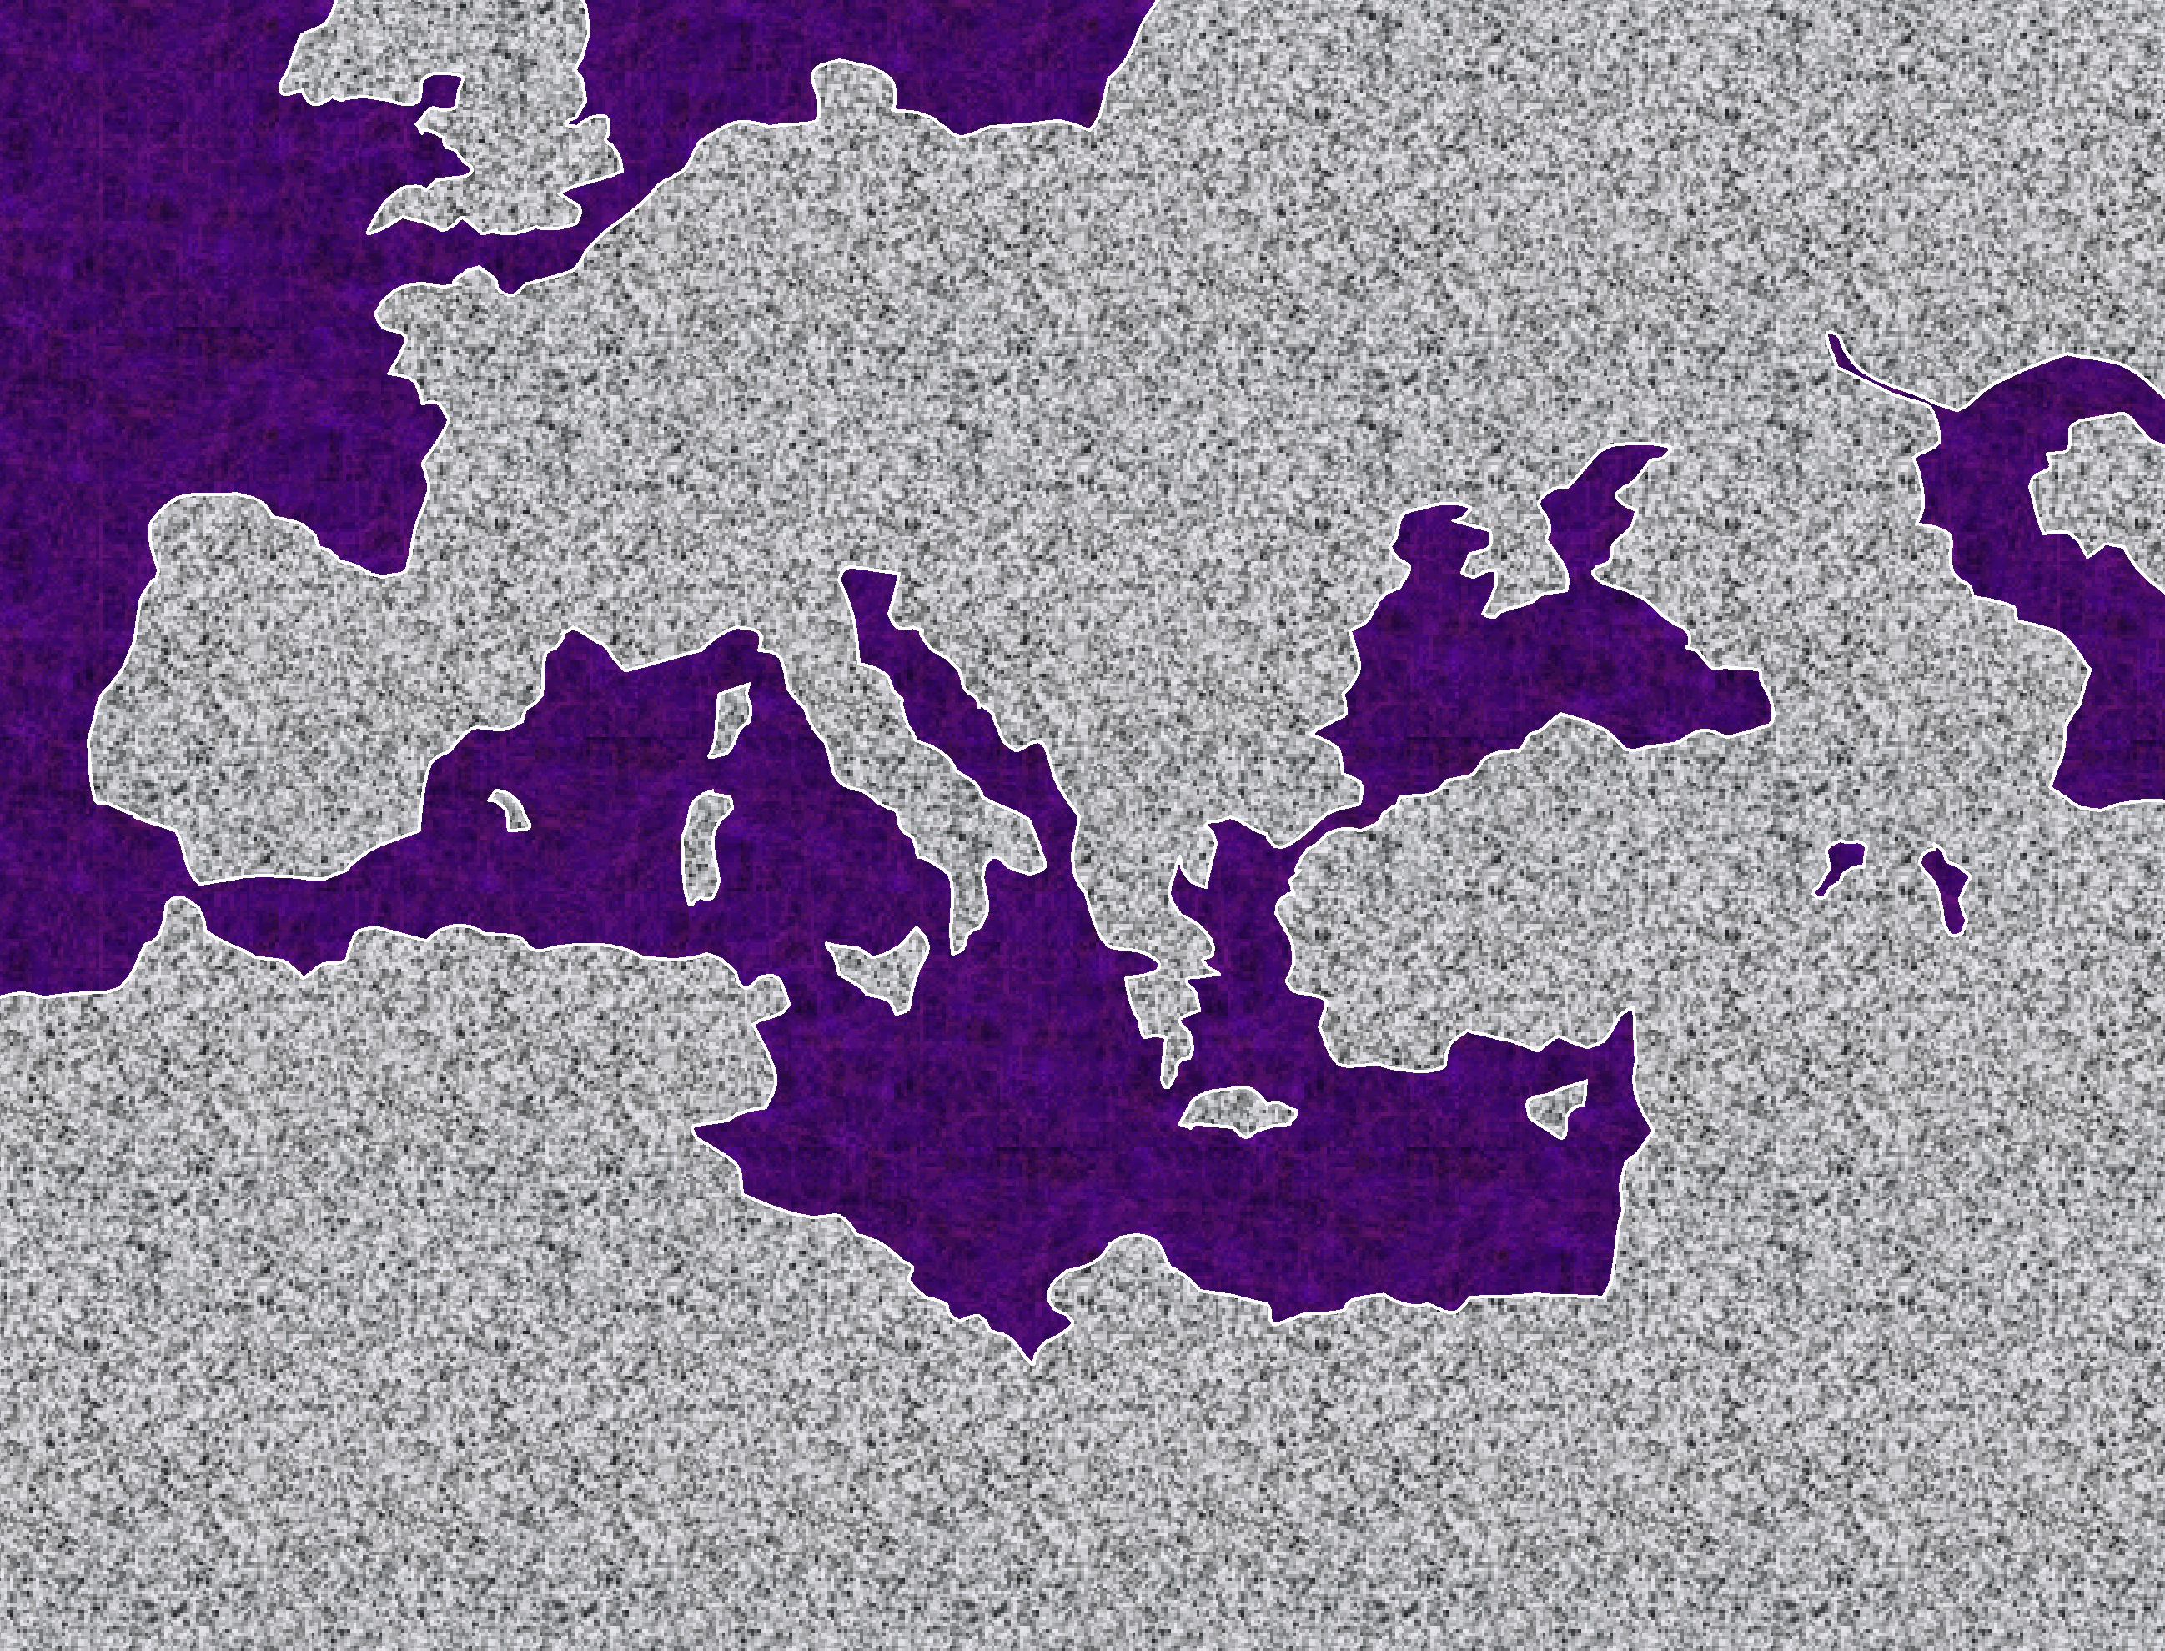
Paul rüvemia ketho puo....Mediterranean zü kezha khie pete nu.!
ATLANTIC OCEAN
ASIA
SILENCE
Alex the Greek
Roman Systems
MEDITERRANEAN SEA
ARABIA
AFRICA
35
Notes:
Understand this! Paul was a real world traveler! And he was all over the Mediterranean Basin…from Palestine in the Ancient Near East to the Boot of Italy…perhaps even as far as Spain.

Slide 36
Kedipuo la hau meyieta ga?
Kekreilamonyü…
Thechü haki....Mhakechüu nu... Kijüu nu dieliekevi liethou nu puo sede kethoko ta kecüla.!!!
9.65.08.
1
©2006 TBBMI
36
Notes:
And why is this important to us…right now? Because…
//// …right here…in these dramatic pages of The Acts…we find the absolute beginnings of world missions.

Slide 37
?
?
?
?
?
N rüve vecha diako la no n mharhü mu n dojü kimhietuo ga?
37
©2006 TBBMI
9.65.08.
Notes:
With that in mind…how would YOU plan and pack for four really long trips…probably into areas of the world of which you and those with you have no prior knowledge. Transportation? Well, you would probably walk most of the way…maybe some horseback…perhaps an occasional donkey cart…then a variety of Roman sailing ships, if available at the time…and anything but first class! How can we appreciate those difficulties…REALLY understand the work and the personal challenges faced by those early missionaries? Here's one way.

Slide 38
?
?
Rüve kenieu:
?
Syrian Antioch
Tarsus
Derbe
Lystra
Iconium
Pisidian Antioch
Phrygian
Galatia
Mysia
Troas (Troy)‏
Samothrace
Neapolis
Philippi
Amphipolis
Apollonia
Thessalonica
Berea
ATHENS
CORINTH
Cenchrea
Ephesus
Caesarea
Jerusalem
Caesarea
Syrian Antioch
Rüve kerieu:
?
?
Rüve seu:
Rüve diau: Romia nu kevo!
Syr.Antioch
Seleucia
Salamis
Paphos
Perga
Pisidian Antioch
Iconium
Lystra
Derbe
Lystra
Iconium
Pisidian Antioch
Perga
Attalia
Syr.Antioch
Syrian Antioch
Galatia
Phrygian
Regions
EPHESUS
Macedonia
Troas
Philippi
Corinth
Philippi
Troas
Assos
Miletus
Cos
Rhodes
Patara
Tyre
Ptolemais
Caesarea
Jerusalem
Caesarea
Sidon
Around Cyprus
Myra
Crete
Fair Havens
Melita
Sicily Syracuse
Rhegium
Puteoli
Forum of Appius
Three Taverns
ROME
Jerusalem Mechii
(a quick trip that changed the Church forever!)‏
Syr.Antioch
Phoenicia
Samaria
JERUSALEM
Samaria
Phoenicia
Syr.Antioch
9.65.08.
4
©2006 TBBMI
38
Notes:
A look at the itinerary itself! There were four main trips throughout the Mediterranean Basin…in both Europe and Asia.
…with one side trip to Jerusalem…that one was a quick trip…but it changed the Church forever and redirected it theological foundations from that moment on!
//// Now look at the list of the cities, towns and regions that were Paul's destinations. He and his traveling parties had to adjust to life in all these places…and the distances between them. What should they say about the Gospel at each location? How would they be received? HOW DO YOU DO THIS MISSIONS TASK IN THE FIRST PLACE? These and all the other sites and distances between them offered challenges of unimaginable difficulty in those ancient days of the Roman world.
City after city…region after region!
//// Notice how often the city of Syrian Antioch appears on Paul's itinerary time after time. It was located about 500 miles north of Jerusalem. That geographical fact shows that much of Paul's living and planning took place far away from Jerusalem, the home of the mother church of the new faith.
//// Now, a few thoughts about these travel routes and the purposes of each trip can give us great insight into Paul's mission, enormous physical effort and the world-shaking results of his work.

Slide 39
?
?
Rüve
kenieu:
?
Syrian Antioch
Tarsus
Derbe
Lystra
Iconium
Pisidian Antioch
Phrygian
Galatia
Mysia
Troas (Troy)‏
Samothrace
Neapolis
Philippi
Amphipolis
Apollonia
Thessalonica
Berea
ATHENS
CORINTH
Cenchrea
Ephesus
Caesarea
Jerusalem
Caesarea
Syrian Antioch
Rüve kerieu:
?
?
Rüve seu:
Rüve diau: Romia nu kevo!
Syr.Antioch
Seleucia
Salamis
Paphos
Perga
Pisidian Antioch
Iconium
Lystra
Derbe
Lystra
Iconium
Pisidian Antioch
Perga
Attalia
Syr.Antioch
Syrian Antioch
Galatia
Phrygian
Regions
EPHESUS
Macedonia
Troas
Philippi
Corinth
Philippi
Troas
Assos
Miletus
Cos
Rhodes
Patara
Tyre
Ptolemais
Caesarea
Jerusalem
Caesarea
Sidon
Around Cyprus
Myra
Crete
Fair Havens
Melita
Sicily Syracuse
Rhegium
Puteoli
Forum of Appius
Three Taverns
ROME
Jerusalem mechii
(a quick trip that changed the Church forever!)‏
Syr.Antioch
Phoenicia
Samaria
JERUSALEM
Samaria
Phoenicia
Syr.Antioch
Mha kedojii kibou
Kekramia perhie kevo
Niathu tsa perhie kevo
Romia mu puo vie mevi
9.65.08.
8
©2006 TBBMI
39
Notes:
Each trip was unique in purpose and accomplishment.
The first trip out…let's call it THE LABORATORY…
//// …then THE EUROPEAN THRUST…
//// …followed by AN ASIAN THRUST…finally…
//// TO ROME AND GAIN!
//// On the first trip…that was THE LABORATORY…a short tour, compared to the later ones, going into present-day central Turkey, turning around and then returning fairly quickly. Paul and his companions were learning what to do –– what best NOT to do –– on the mission field!
//// And then the great Jerusalem Council…more on that shortly.
//// Then the EUROPEAN THRUST…where Paul's main activities centered on philosophical Athens and the rough seaside city of Corinth.
//// In his ASIAN THRUST … Paul lived for a very long time in the city of Ephesus…then following these decades of inventing “mission”…
//// …his final trip as a prisoner to Rome…TO ROME AND GAIN…and from there to eventually join His Lord after a life well lived in pursuit of the Gospel and the Great Commission…laying down the pattern of courageous Christian behavior for us all.

Slide 40
ATLANTIC OCEAN
KEKRAMIA
NIATHU TSA
AFRICA
ISRAEL
MEDITERRANEAN SEA
ARABIA
40
© 2006 TBBMI
9.65.08.
Notes:
To frame all this…again look at Israel on the map…resting there in that far eastern end of the Mediterranean…as we looked at it in the Silent Period…

Slide 41
ROMIAKO KEDI RüVE
ATLANTIC OCEAN
EUROPE
ROME•
ASIA
•
AFRICA
ISRAEL
MEDITERRANEAN SEA
ARABIA
41
© 2006 TBBMI
9.65.08.
Notes:
,…situated up against the vastness that was the Roman Empire.

Slide 42
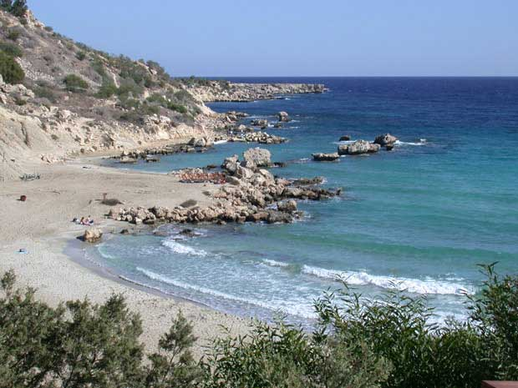
1.“Mha kegou nya: mha kedojii kebou ”
STUDY HELP #24
PAUL'S JOURNEYS …AT A GLANCE
ATLANTIC OCEAN
A.D. 46-48
EUROPE
A BEACH ON CYPRUS
ASIA
ROME•
Macedonia
•
•Pisidian Antioch
AFRICA
Athens
•Ephesus
Acts 13-14
•Syrian Antioch
MEDITERRANEAN SEA
•Jerusalem
Mhatho kemeyieko:Ukepenuopfü üdi rüsuokecü;Ungo mhatho chüshü;ketse pie Paul vakewa;mhathoko puo kere;kehouki pesiekeshü/sedekeshü;vo kecü hau nunu la vorketa.
ARABIA
42
14
© 2006 TBBMI
9.65.08.
Notes:
With these ideas in mind…and with Study Help #24…let's go with Paul on his JOURNEYS AT A GLANCE. First…the main locations of the dramatic action facing Paul and his little party…
//// Here is Jerusalem…
//// SYRIAN Antioch…
//// PISIDIAN Antioch…(there were many ancient Antiochs!)…
//// Ephesus…
//// Macedonia…(Remember Alexander's birthplace?)…
//// Athens…
//// and the capital city of the world of his day…ROME, at the center of Empire.
//// So…Trip #1: Call it the HOOK…or A LABORATORY on Study Help #24…
//// Recounted in some detail in Acts 13 and 14.
//// Here's a Cyprian beach typical of those Paul and his party would have moved across.
//// On your map trace out his route similar to A HOOK SHAPE that moves from SYRIAN ANTIOCH through the island of Cyprus and on into central Turkey.
//// Significance of this trip: IT WAS A LEARNING LABORATORY! No one had done this before. Along the way they were worshipped as GODS…because the people had never seen anything like this…these strangers were going about working miracles. But in spite of those good works, Paul was STONED and almost died. The party must have quickly recognized that mission would become a very difficult work indeed. But along the way many new churches were planted. What kept them going? Faith in all they had seen and experienced in the development of their own Christian spirit and intellect. Their travel route began at Syrian Antioch – follow your hook – into today's central Turkey…
//// …then they turned around and returned to Syrian Antioch by the same route, there to report the results of their journey to the church.
//// LENGTH OF THIS TRIP: PROBABLY ABOUT TWO YEARS
IN THE LAST HALF OF THE A.D. 40s.

Slide 43
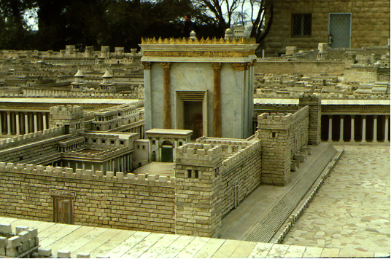
1(--)2“Jerusalem Vie Mechii”
A.D.49
Mhakechüko 15:1—Juda kemomia bu Judamia chü,mu sidi thezhoko mu nanyü cako chüwa morosupuo bu Khrista kitsa mia chüketuo la.
ATLANTIC OCEAN
EUROPE
NGUKEMEZHIE RiiBEI!
ASIA
ROME•
•Macedonia
•Pisidian Antioch
Athens
•Ephesus
AFRICA
Acts 15
•Syrian Antioch
MEDITERRANEAN SEA
1(--)2“Jerusalem vie mechii”
•Jerusalem
Thenyieko pepikemesa pie zhüwate;thezho-u mo di ngukemezhie!
ARABIA
© 2006 TBBMI
9.65.08.
43
4
Notes:
Paul apparently had little time to rest up.
//// In about A.D. 49 he made that special SHORT trip between the BIG TRIPS #1 and #2…for the famous JERUSALEM COUNCIL.
This was a 500-mile journey from Syrian Antioch, south to the city of the mother church…to Jerusalem.
//// The issue here –– told to us in Acts 15 –– was the simple question:
“Must a Gentile become a Jew, and accept his laws and ceremonies, before he can become a Christian?” It must have been a heated argument!
//// Finally the issue was permanently settled: one becomes a Christian through GRACE…not LAW. However, if following the law makes one comfortable, fine. Accepting Christ as Lord and Savior is a matter of belief and relinquishment –– that is the only requirement! GRACE AND GRACE ONLY!
//// Then Paul and his party returned north to Syrian Antioch. Our BASIC BELIEFS of today date firmly from that Jerusalem meeting of Acts 15. Later reformers of the church also anchored their Christian tenets right there – dating from the Jerusalem Council.

Slide 44
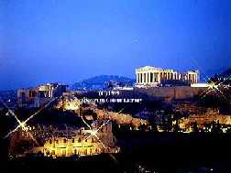
2. “Kekramia Perhie Kevo”
ATLANTIC OCEAN
A.D. 49-52
EUROPE
ANCIENT ATHENS
ASIA
ROME•
•Macedonia
•Pisidian Antioch
•
•Ephesus
AFRICA
Athens
Acts 15-18
•Syrian Antioch
MEDITERRANEAN SEA
2.“Kekramia perhie kevo ”
•Jerusalem
ARABIA
Mhatho kemeyie ko: ;kehou kekra sedekeshü;Macedonia kekie;Athens nu kevo, “sikemo Kepenuopfü"; Mars Hill;Corinthian nu ba kepecha.
44
5
©2006 TBBMI
9.65.08.
© 2006 TBBMI
Notes:
Paul then began to prepare for extended missionary trips.
//// Trip #2…THE EUROPEAN THRUST…is recalled in detail in Acts 15 through 18.
//// This second journey began overland from Syrian Antioch…all the way into Greece…then returning by sea to make his report to the church in Jerusalem…then back home to Syrian Antioch.
//// There were church plants along the way… They met in synagogues every Sabbath…speaking either Greek –– thanks to Alexander the Great –– or Hebrew or Latin. Paul spoke all those languages. This is the time of that famous call to “come over to MACEDONIA and help us.” And then he took up a lengthy residence in the wild, seaside town of CORINTH, only a short journey from Athens.
//// On this trip he debated with the Athenian philosophers on Mars Hill, recognizing their statue to “the unknown God.” He built a sermon around that!
//// LENGTH OF THIS TRIP: ESTIMATED AT ABOUT TWO AND A HALF YEARS BETWEEN A.D. 49 AND 52.

Slide 45
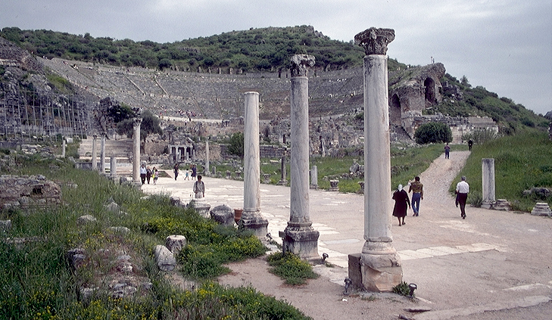
3.“Niathu Tsa Vie Perhie Kevo”
A.D. 53-57
ATLANTIC OCEAN
EUROPE
ANCIENT EPHESUS
ROME•
•Macedonia
ASIA
•Pisidian Antioch
•
•Ephesus
AFRICA
Athens
Acts 18-21
•Syrian Antioch
MEDITERRANEAN SEA
3.Niathu tsa vie perhie kevo”
•Jerusalem
Mhatho kemeyieko;Ephesus kehou nu puotei kehe di bacha kewa;khriesamia chü perhi la keshii;leshü kemeyie khuthu;Ephesian artisans at amphitheatre ze kebvü se keta .
ARABIA
9.65.08.
45
4
© 2006 TBBMI
9.65.08.
Notes:
Then came Paul's ASIAN THRUST…recorded in Acts 18-21.
//// Again, this trip began overland from Syrian Antioch…revisited many of the earlier churches…made a horseshoe-shaped route around the Aegean, back down into Greece, retraced that route back around the horseshoe, remaining at Troas, then returning by sea to Syrian Antioch.
//// Paul spent a very long time living and ministering to the church the EPHESUS. Luke reports that Paul raised a young man from the dead in Ephesus. Many important letters –– our Epistles –– were written from Ephesus.
//// One of the most dramatic events recorded for us took place at the Ephesian AMPHITHEATRE where he confronted the souvenir makers of the city…those who manufactured small idols of the Goddess Diana, whose temple in Ephesus was one of the seven wonders of the ancient world.
//// LENGTH OF THIS TRIP: ALMOST FIVE YEARS BETWEEN A.D. 53 AND 57.

Slide 46
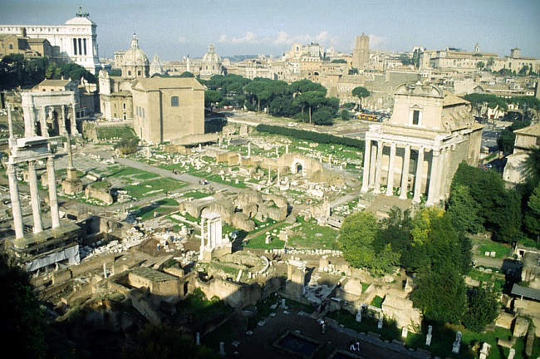
4. “Romia mu puo vie mevi!”
A.D. 59-62
ATLANTIC OCEAN
EUROPE
ASIA
ROME•
ROME'S ANCIENT FORUM
•Macedonia
•Pisidian Antioch
•
•Ephesus
AFRICA
Athens
Acts 21-28
•Syrian Antioch
MEDITERRANEAN SEA
4.”Romia mu puo vie mevi!”
•Jerusalem
ARABIA
Mhatho kemeyieko: kediamia chü di Romia nu ketse keshü; kedia kinu mu caesar kinu Khristamia hü keshü; leshü kemeyie khuthu;’’kuokelie mu kepele nu metitha ba zolie!”
9.65.08.
46
3
© 2006 TBBMI
9.65.08.
Notes:
Finally…Trip Number 4…Acts 21-28…“To Rome and Gain”…. describes Paul's final journey: Remember that Paul once wrote that for him to live was Christ…and to die would be his eternally great gain!
//// On this journey, he left an Roman prison in Caesarea –– on the Israeli coast –– boarding a Roman grain ship, then by sea to Italy with frequent stops along the way, landing at a small town near today's Naples, finally traveling on foot with friends to his imprisonment in Rome.
//// As a prisoner of ROME he was sent there for trial. But even in Rome, while in rented quarters (Acts 20:28-29), his passionate missionary spirit brought the Gospel into that house and from there into the very household of CAESAR. In prison he wrote four important letters. Some scholars believe he made an additional trip to Spain, but that is not certain. Six years later from Rome during his second imprisonment he gave the anthem for the well-lived life: “I have fought the good fight, I have kept the faith!” (2 Tim. 4:7).
//// LENGTH OF THE TRIP AND STAY IN ROME UNTIL HIS DEATH…ABOUT FOUR YEARS…A.D. 59-62.
//// Study Help 36 gives a finished view of all of Paul's travels along with their approximate dates according to good scholarship.

Slide 47
STUDY HELP #36
#1 THE HOOK: A LABORATORY
AT A GLANCE: PAUL'S MISSIONARY JOURNEYS
ATLANTIC OCEAN
EUROPE
(leshüda mepfüepuo)‏
INTERIM: JERUSALEM COUNCIL
Kehou dzeüse ko
ASIA
#2: THE EUROPEAN THRUST
AFRICA
Apostelko mhatho
#3: THE ASIAN THRUST
ARABIA
#4: TO ROME AND GAIN
9.65.08.
47
7
Notes:
Okay…to sum up this remarkable record of missions ministry…PAUL'S MISSIONARY JOURNEYS AT A GLANCE…
//// First Journey…The Hook…the Laboratory…learning what mission was all about…
//// Then, in the interim, the famed Jerusalem Council…a matter of Grace…at the core of Christian theology…we no longer live under Law…
//// The Second Journey…the European Thrust…with a long period of residence in Corinth, near Athens…
//// The Third Journey…the Asian Thrust…this time, headquartered for a long while at Ephesus, in today's Turkey…
//// and finally…The Fourth and Last Journey…to Rome and gain…with a long imprisonment…producing some of his more memorable letters.
//// Now…with the geographic stage set…for a young church spreading throughout the Mediterranean Basin…time now to delve into the Epistles or Letters themselves.
= = = = = = = = = = = = = = = = =
Now we come to the New Testament's vast treasury of spiritual insight and instruction known as…
//// …THE EPISTLES…or letters of direction to the early Church. These unique writings have given to the world incomparable lessons on the deepest meanings of the Christian faith and the infinite variables of living a life in the Spirit.

Slide 48
(leshiida mepfiiepuoo)‏
Kehou dzeiise ko
Apostelko khuthu: Paul leshü thukeshü
Khuthu teisozhau:
A.D. 50s - 90s
THE EPISTLES
Concerning generally unexplored issues requiring new and crucial instruction in leadership of the new organism...
the ECCLESIA,
the CHURCH.
Most letters from Paul …fewer letters from “The Others.”
Kekreimia kinu leshü
ngukelie
Letters from
The Others
48
3
Notes:
So the New Testament continues to come together in a collection of works called Epistles. Actually we have 21 very personal letters…
//// ….concerning generally unexplored issues requiring new and crucial instruction in leadership of that new organism, the ECCLESIA, the called-out ones, the CHURCH.
//// There are two large groups of these letters. Those from the Apostle Paul…and the letters from “The Others,” sometimes called the General Epistles.
//// These letters were written across the five decades from the A.D. 50s to the 90s..

Slide 49
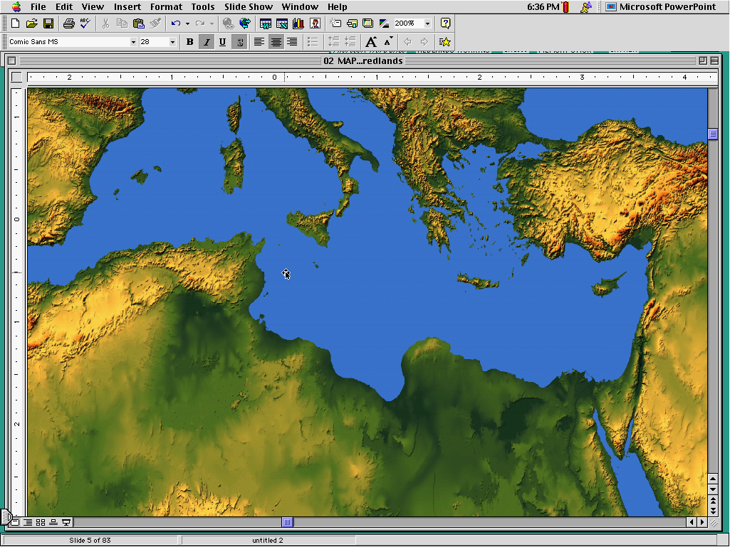
KERIEKI KEHOU KEYIE VOKELIE
REPRESENTATIONAL LOCATIONS ONLY
9.65.08.
©2006 TBBMI
49
Notes:
[ON MED MAP: AUTO INSERTION OF 31 DOTS INDICATING NEWLY PLANTED CHURCHES –– REPRESENTATIVE ONLY]
As a means of wide communication, these circular letters were written to the new churches all across the Mediterranean Basin-- from Palestine to today's Italy, Greece, Turkey and Crete. They dealt –– then and now ––with all matters imaginable of life and living among members of the many churches springing up throughout the region.

Slide 50
Apostel khuthuko kehou sedekelie therieko la puo mvüdze chükeshü...…
• kekrokelie, mhachükelie, mu chü kemeyakelie
• kehou nu kelhou
• kikru nu kelhou
• kehou nu thepfümia mu thenumia donu kelhou
• ruopfüu nu kelhou
• mhatho pelekeshüu kezhau chü tseikelie
©2006 TBBMI
9.65.08.
50
6
Notes:
They provided the early church with its foundational principles of
//// organization, operation and expansion…
//// for life in the church,
//// for life in the family,
//// for life among the men and women of the church, and most importantly,
//// for an ever-expanding personal life in the Spirit while directing
//// efforts of the new Church toward accomplishment of The Great Commission.

Slide 51
(21 Books)‏
CHURCH
ISSUES
THE EPISTLES: Letters from Paul
SüLA KETSOKECü KEZHATHO-U LIRO?
KEDIPUO,KIRAPUO?
Letters from
The Others
KEPHRü KEKHRUOHI # 20
51
Notes:
Now...one of the problems with the epistle collection is this: many works with strange titles, and no apparent way to remember what goes where. How do you keep all these individual works in their right order? For many Bible readers, this is a huge challenge. So, here is a series of suggestions that might remedy that situation for you. Work along with your Study Help #20.

Slide 52
Leshüda mepfüepuo)‏
PAUL THUKESHü LESHüKO
Kehou nu nyieko
Apostelko khuthu
Paul dieyie
leshü :
“Romiako kro puo korinth kenie baya.”
}
Romiako
Korinthiako kerieu
korinthko
PUOTEI KEMEYIE KROPUO NU KEHOU KERIEMIAKO PETHAKECü
Korinthiako kerieu
Korinthiako kenieu
52
1
Notes:
Let's begin with the letters from Paul….starting here…
//// …with this little sentence: "Most ROMANS have 2 CORS." (Note the spelling of COR: C…O…R…S.) And with the car traffic in Rome being what it is, the little sentence is very true. For our purposes then, this tells us the order of the first three epistles of Paul:
ROMANS,
FIRST CORINTHIANS, and
SECOND CORINTHIANS. Got the idea?

Slide 53
(Leshüda mepfüepuo)‏
PAUL THUKESHü LESHüKO
Kehou nu nyieko
Apostelko khuthu
Paul dieyie leshü:
“Romiako kro puo korinth kenie baya.”
romiako
Korinthko kerieu
Korinthko kenie
Galatiako
Efesako
Filipiko
korinthiako
}
PUOTEI KEMEYIE KROPUO NU KEHOU KERIEMIAKO PETHAKECü
“Juda kemoko thevochü kecü.”
Galatiako
Efesako
Filipiko
kolosiko
53
1
Notes:
Next group: beginning with its identifying sentence:
//// Gentiles Eat Pork Chops." The beginning letters are G-E-P-C... which gives us in order,
GALATIANS...
EPHESIANS...
PHILIPPIANS...and
COLOSSIANS."
Getting the idea now? These little tools of mental organization can do wonders toward clarifying the way we put the pieces of the Book together mentally...and after that...the way we can quickly recall them and put them together for more effective Bible study and spiritual development in one's quiet time.

Slide 54
(Leshüda mepfüepuo)‏
PAUL THUKESHü LESHüKO
Kehou nu nyieko
Aposletko khuthu
Paul dieyie leshü:
“Romiako kro puo korinth kenie baya.”
Romiako
Korinthko kerieu
Korinthko kekieu
Galatiako
Efesako
Filipiko
kolosiko
PUOTEI KEMEYIE KROPUO NU KEHOU KERIEMIAKO PETHAKECü
“Juda kemoko thevochü kecü.”
Thesoloniako kerieu
2 Thesoloniako kenieu
1 Timothi kerieu
2 Timothi kenieu
Tita
}
Thekrü chü:mhase Niepuu liethonu keshü u melou kesuoko..”
Thesoloniako kerieu
Thesoloniako kenieu
Timothi kerieu
Timothi kenieu
Tita
54
1
Notes:
Now...try this one...
//// this is the church treasurer's constant lament: you know...it's "THOSE TIMID TITHERS." First letters of the words -- TH...TI...TIT...deliver this result:
FIRST AND
SECOND THESSALONIANS...
FIRST AND
SECOND TIMOTHY...
AND TITUS.

Slide 55
(Leshüda mepfüepuo)‏
PAUL THUKESHü LESHüKO
Kehou nu nyieko
Aposletko khuthu
Paul dieyie leshü:
“.”
“Romiako kro puo korinth kenie baya.”
Romiako
Korinthko kerieu
Korinthko kekieu
PUOTEI KEMEYIE KROPUO NU KEHOU KERIEMIAKO PETHAKECü
“Juda kemoko thevochü kecü.”
Thesoloniako
kerieu
Thesoloniako kenieu
Timothi kerieu
Timothi kenieu
}
Thekrü chü :mha se Niepuu lietho nu keshü u melou kesuoko.”
}
Filemon
“Paul diezho keprhü puo
thela kechü.”
Filemon
55
1
Notes:
One more book from Paul's quill and we have completed his collection:
//// Here is the clue...we have come to the end of Paul's FILE...as in BIBLE FILE...however, we spell it PHILE...PH instead of F...
and this stands for the epistle named PHILEMON.

Slide 56
(Leshüda mepfüepuo)‏
PAUL THUKESHü LESHüKO
Kehou nu nyieko
Aposletko khuthu
Paul dieyie leshü:
Paul thukeshü leshüko puo siesotseitou kelie.
Romiako
Korinthko kerieu
Korinthko kekieu
Galatiako
Efesako
Filipiko
kolosiko
PUOTEI KEMEYIE KROPUO NU KEHOU KERIEMIAKO PETHAKECü
Thesoloniako kerieu
Thesoloniako kenieu
Timothi kerieu
Timothi kenieu
Tita
filemon
56
Notes:
Here is the complete collection of Paul's letters: remembering the little mental tools for...ROMANS, FIRST AND SECOND CORINTHIANS, GALATIANS, EPHESIANS, PHILIPPIANS, COLOSSIANS, FIRST AND SECOND THESSALONIANS, FIRST AND SECOND TIMOTHY, TITUS and PHILEMON.

Slide 57
Kephrü kekhruohi #25
Paul ketho nanyü kephrü dze kemeyie kenie Khristamia keleu mu medziyakezhau mvüdze
CHü KEMEZHüKESHü:- kephouma üse pejopie tuoketau nunu shüphra kerüü keshü..... Mu chü kemiathokelie
(AN INSTANT “VA PUO EVENT!)‏
Keriekitho 15:6 Abram Jihova pelelie,mu süla Jihovae puo üse miatho ü ta.
CHü KEMESAKELIE -- kerüshü,kerü nunu setuo keta vieko geinu sekho kekreipar kelie.
(A CONTINUING MATURING PROCESS!)‏
Korintko kerieu1:2 Thupie korint nu Ukepenuopfü kehouu,Jisu Khrista lanu chü kemesalie keta mu kemesako üdi kielieketako tsiu kehourapuorei lie mu uko Niepuu üdi Niepuu Jisu Khrista za kielieketa peteko ki kesh ü ;--
2 Cor. 5:17 and Rom. 5:1-4
57
8
Notes:
Before we leave Paul's part of the Epistles collection, move to Study Help #25…where…
//// …we'll indicate two anchor points in all that he thought, taught, and wrote. Two of Paul's key theological truths are significant because they are the very foundation of Christian thought and practice.
//// First…the word JUSTIFICATION…which means to release from the guilt of sin and to make RIGHTEOUS…
//// The point being: JUSTIFICATION is an instant “one-time” event.
//// JUSTIFICATION takes us straight back to Abraham and his encounter with God in Genesis 15:6. The Word reports that “Abram believed the Lord and he [God] credited it to him as righteousness.”
//// And then…SANCTIFICATION…that word meaning “to set apart for some sacred use.”
//// Unlike JUSTIFICATION… SANCTIFICATION is a CONTINUING maturing process…growing daily, maturing steadily!
//// In 1 Corinthians 1:2…Paul wrote: “To the church of God in Corinth, to those sanctified in Christ Jesus and called to be holy, together with all those everywhere who call on the name of our Lord Jesus Christ…”
Additional references to sanctification are found in 2 Corinthians 5:17 and Romans 5: 1-4.
//// JUSTIFICATION…A ONE-TIME EVENT… SANCTIFICATION… A CONTINUING MATURING PROCESS

Slide 58
(leshüda mepfüepuo)‏
Kekreimiako kinu thukeshü leshüko”
Kehou nu nyieko
Aposletko khuthu
Paul dieyie leshü:
IBRIKO
JACOB
PITOR KERIEU
PITOR KENIEU
JOHAN KERIEU
JOHAN KENIEU
JOHAN SEU
JUDA
Romiako
Korinthko kerieu
Korinthko kekieu
Galatiako
Efesako
Filipiko
kolosiko
Thesoloniako kerieu
Thesoloniako kenieu
Timothi kerieu
Timothi kenieu
Tita
filemon
Kekreimia kinu
leshüko
Peteko la Apostelko khuthuko (Paul kinu nu kemo)
Ibriko
Jerusalem television nu,
Ibriko(s) die nu thedze pukeshü-u...
JAMES,
P ITOR
JOHAN,
mu
JUDA.”
Jakob
1 Pitor
2 Pitor
1 Johan
2 Johan
3 Johan
Juda
©2006 TBBMI
58
3
Notes:
Time now to complete the epistle collection with those penned by the OTHER writers on the ancient scene at the time.
//// These are the letters from the Others…or otherwise known as The General Epistles.
//// And there is a clue for you about this one: you see...in Jerusalem...a place with a lot of media on the air all the time…there IS a HEBREW TELEVISION NEWS CREW...and its crew is made up of four guys...JAMES...PETER...JOHN...and JUDE.
And that, in turn, produces these final epistles in order:
//// HEBREWS, JAMES, FIRST PETER, SECOND PETER, FIRST JOHN, SECOND JOHN, THIRD JOHN and finally…JUDE.
These are little mental tricks that can mean the difference between a freedom of movement among the New Testament books and letters…or a source of confusion that simply closes the book to many people intellectually and to the others we encounter in our daily lives.

Slide 59
(leshüda mepfüepuo)
kehou nu keee‏
Aposletko khuthu
Paul dieyie leshü:
Ketholeshü kesau nu Apostels ko khuthuko kengu tseikelie. (Leshüko)
“Romiako kro puo korinth kenie baya.”
Romiako
Korinthko kerieu
Korinthko kekieu
Romans
1 Corinthians
2 Corinthians
Galatians
Ephesians
Philippians
Colossians
“Juda kemoko thevochü kecü.”
.”
The Church Treasurer's
Lament:
“THose TIMid TIThers.”
1 Thessalonians
2 Thessalonians
1 Timothy
2 Timothy
Titus
Kehou nu nyieko
Kehou nu nyieko
Philemon
“The end of Paul's PHILE.”
Letters from
The Others
Hebrews
“Jerusalem television nu,
Ibriko(s) die nu thedze pukeshü-u...
JAMES,
P ITOR
JOHAN,
mu
JUDA.”.”
James
1 Peter
2 Peter
1 John
2 John
3 John
Jude
©2006 TBBMI
59
5
Notes:
Here, then, is the complete collection of all the letters from all the writers., with all of those mental tools for sorting and remembering their order...from the top down…
//// ROMANS...FIRST AND SECOND CORINTHIANS...
//// GALATIANS...EPHESIANS...PHILIPPIANS...COLOSSIANS
//// ...FIRST AND SECOND THESSALONIANS...FIRST AND SECOND TIMOTHY...TITUS...
//// PHILEMON...
//// HEBREWS...JAMES... FIRST AND SECOND PETER...FIRST, SECOND, AND THIRD JOHN...AND JUDE.

Slide 60
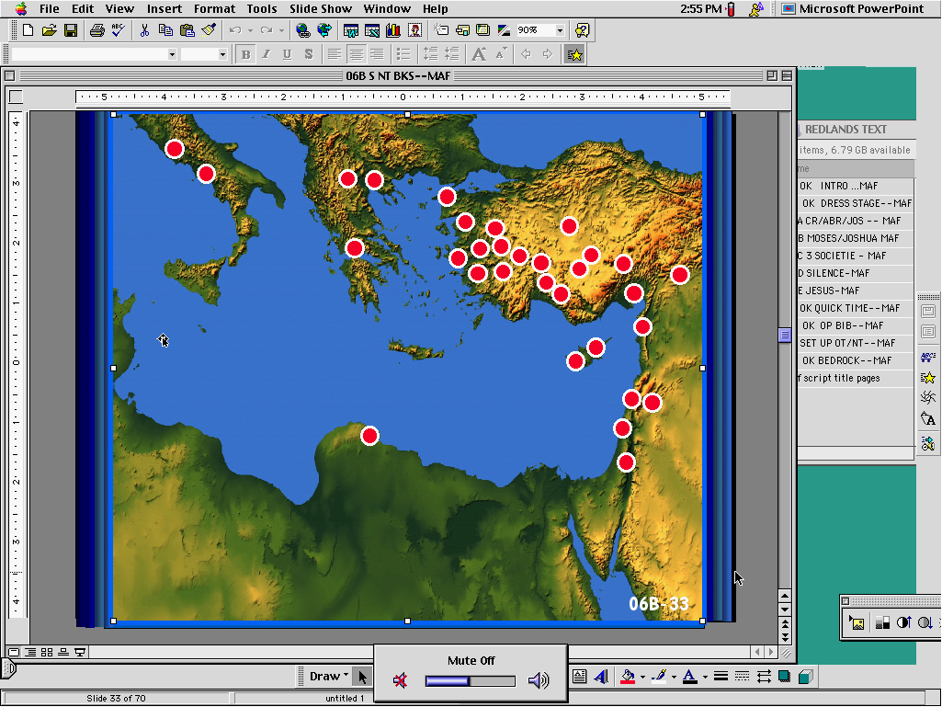
(leshüda mepfüepuo)‏
Kehou nu nyieko
Aposletko khuthu
Paul dieyie leshü:
Romiako
Korinthko kerieu
Korinthko kekieu
Aposletko khuthu ketholeshü-u kengutsei kelie
Galatiako
Efesako
Filipiko
kolosiko
Thesoloniako kerieu
Thesoloniako kenieu
Timothi kerieu
Timothi kenieu
Tita
Kehou keriemia ko la leshü thukeyiekeshü
filemon
Kekreimia kinu
dieyie leshü
Ibriko
Jacob
1 Pitor
2 Pitor
1 Johan
2 Johan
3 Johan
Juda
60
Notes:
These are the letters that have come down to us through history. There may very well have been others, but these are the ones God saw fit to preserve for us today.

Slide 61
Kedipuo la siiko thupie therie nu zhii ga?
Leshii thukeshii puo kele kikechii iita?
61
1
Notes:
Before we leave the Epistles, we should answer a question often asked of Bible teachers. First…what about the ideas behind the letters?
//// In other words…why were they written in the first place?

Slide 62
Kephrü kekhrohi #26
Apostelko khuthu-e leshüko zo”…
…keza kenie keshü....
THE PAULINE EPISTLES
Paul thukeshü leshüko
THE GENERAL EPISTLES
Kekreimia thukeshü leshüko”
62
6
Notes:
With Study Help 26 to help put this together….
//// As earlier…the epistles are actually letters…
//// …in two sections.
//// …the so-called PAULINE EPISTLES…
//// …and the GENERAL EPISTLES…
//// OR…the letters that Paul wrote…
//// and the letters from “the others.”

Slide 63
Kerieu: Paul kinu dieyie leshü
ROMIAKO
1 KOR
2 KOR
GALATIAKO
EFESAKO
FILIPIKO
KOLOSIKO
Kepele geinu chü kemezhü keshü
Kehouki nu kristamia mhatho
Paul Apostel kekuo thakeshü
Ngukemezhie puo kekuo
kepeleko thau nu uko tuokeshü
Jisu Khrista uko keneiu zo
Jisu Khrista geinu ketshukelhuo ngukelie
1:17
1:2
12:9
3:2
1:3
4:4
2:10
1 CORINTHIANS 1:2
To the church of God in Corinth, to those sanctified in Christ Jesus and called to be holy, together with all those everywhere who call on the name of our Lord Jesus Christ--their Lord and ours: (NIV)‏
2 CORINTHIANS 12:9
But He said to me, “My grace is sufficient for you, for my power is made perfect in weakness.” Therefore I will boast all the more gladly about my weaknesses, so that Christ's power may rest on me. (NIV)‏
ROMANS 1:17
For in the gospel a righteousness from God is revealed, a righteousness that is by faith from first to last, just as it is written: "The righteous will live by faith” (NIV).‏
EPHESIANS 1:3
Praise be to the God and Father of our Lord Jesus Christ, who has blessed us in the heavenly realms with every spiritual blessing in Christ. (NIV)‏
GALATIAKO 3:2
A die hayoha nieko kinu si nyükechü zo;thezho-u nu chü morokesuoko chükechü la,
COLOSSIANS 2:10
…and you have been given fullness in Christ, who is the head over every power and authority (NIV).‏
PHILIPPIANS 4:4
Rejoice in the Lord always.
I will say it again: Rejoice!
63
7
Notes:
First…the letters from Paul's pen…giving just one main idea from each of those letters…there are certainly other ideas beyond these.
For instance…
+ + + + + +
//// ROMANS 1:17…Justification by FAITH…
“For in the gospel a righteousness from God is revealed, a righteousness that is by faith from first to last, just as it is written: 'The righteous will live by faith.'” (NIV)
+ + + + + +
//// 1 CORINTHIANS 1:2…concerning Christian conduct in the church…
“To the church of God in Corinth, to those sanctified in Christ Jesus and called to be holy, together with all those everywhere who call on the name of our Lord Jesus Christ – their Lord and ours:” (NIV)
+ + + + + +
//// 2 CORINTHIANS 12:9….about the authenticity of Paul's apostleship…
“But He said to me, 'My grace is sufficient for you, for my power is made perfect in weakness.' Therefore I will boast all the more gladly about my weaknesses, so that Christ's power may rest on me.” (NIV)
+ + + + + +
//// GALATIANS 3:2…on the power of GRACE… “I would like to learn just one thing from you: Did you receive the Spirit by observing the law, or by believing what you heard?” (NIV)
+ + + + + +
//// EPHESIANS 1:3…about the position and walk of the believer…
“Praise be to the God and Father of our Lord Jesus Christ, who has blessed us in the heavenly realms with every spiritual blessing in Christ.” (NIV)
+ + + + + +
//// PHILIPPIANS 4:4…Jesus Christ our joy…
“Rejoice in the Lord always. I will say it again: Rejoice!”
+ + + + + +
//// COLOSSIANS 2:10…Jesus Christ: totally adequate…
“…and you have been given fullness in Christ, who is the head over every power and authority.” (NIV)
+ + + + + +

Slide 64
FIRST: THE LETTERS FROM PAUL
ROMiakko
1 kor
2 kor
GALATIAko
Efesako
filipiko
kolosiko
Kepele geinu nu chü kemezhü keshü
Kehouki nu kristamia mhatho
Paul Apostel kekuo thakeshü
Ngukemezhie puo kekuo
kepeleko thau nu uko tuokeshü
Jisu Khrista uko keneiu zo
Jisu Khrista geinu ketshukelhuo ngukelie
1:17
1:2
12:9
3:2
1:3
4:4
2:10
1 THES
2 THES
1 TIMOTHi
2 TIMOTH
TIta
FILEMON
Niepuu vor ketuo teisozhau
Kehouki nu mhathoko puotuo nu bakelie
Dieliekeviu yalie, dieliekeviu puzhüzolie
Kehou nu phichümiako bu medzi morokesuo
Khrista geinu kekreimia zekelie
Puotei thela nhie mhathoko
1:10
1:6
2:8
1:13
2:1-2
vv. 17-18
2 THESSALONIANS 1:6
God is just: He will pay back trouble to those who trouble you and give relief to you who are troubled, and to us as well. This will happen when the Lord Jesus is revealed from heaven in blazing fire with his powerful angels. (NIV)‏
2 TIMOTHY 1:13
What you heard from me, keep as the pattern of sound teaching, with faith and love in Christ Jesus. (NIV)‏
1 TIMOTHY 2:8
I want men everywhere to lift up holy hands in prayer, without anger or disputing. (NIV)‏
1 THESSALONIANS 1:10
…and to wait for his Son from heaven, whom he raised from the dead -- Jesus, who rescues us from the coming wrath. (NIV)‏
FILEMON 17-1
Süla no a ü n kromia üliro a mhie puo zeliechie.sirei puo n gei mha chüzhükemo huo chüwata,morei n pu pfüzhü ümharo;a za nu thupie zhüliechie
TITUS 2:1-2
You must teach what is in accord with sound doctrine…Teach the older men to be temperate, worthy of respect, self-controlled, and sound in faith, in love and in endurance. (NIV)
9.65.08.
5
©2006 TBBMI
64

Slide 65
FIRST: THE LETTERS FROM PAUL
ROMANS
1 COR
2 COR
GALATIANS
EPHESIANS
PHILIPPIANS
COLOSSIANS
JUSTIFI- CATION BY FAITH
CHRISTIAN CONDUCT IN THE CHURCH
PAUL'S AUTHENTIC APOSTLE-SHIP
THE POWER OF GRACE
POSITION AND WALK OF THE BELIEVER
JESUS CHRIST OUR JOY
JESUS CHRIST: TOTALLY ADEQUATE
2 PETER 2:1
But there were also false prophets among the people, just as there will be false teachers among you. They will secretly introduce destructive heresies, even denying the sovereign Lord who bought them--bringing swift destruction on themselves. (NIV)‏
3 JOHN vv. 4, 11
I have no greater joy than to hear that my children are walking in the truth…Dear friend, do not imitate what is evil but what is good. Anyone who does what is good is from God. Anyone who does what is evil has not seen God. (NIV)‏
1 Peter 2:7
Now to you who believe, this stone is precious. But to those who do not believe, "The stone the builders rejected has become the capstone,” (NIV)‏
JUDE vv. 20-21
But you, dear friends, build yourselves up in your most holy faith and pray in the Holy Spirit…Keep yourselves in God's love as you wait for the mercy of our Lord Jesus Christ to bring you to eternal life. (NIV)‏
Jakob 2:26 U mo zo rei ruopfüu sa ba mo ro siatayakezha tuoi kepele puo mhatho sa mo liro süsü tuoi kesia zokecü la.
Hebrews 1:4
So he became as much superior to the angels as the name he has inherited is superior to theirs. (NIV)‏
1 JOHN 5:13
I write these things to you who believe in the name of the Son of God so that you may know that you have eternal life. (NIV)‏
2 JOHN v.3
Grace, mercy and peace from God the Father and from Jesus Christ, the Father's Son, will be with us in truth and love. (NIV)‏
1:17
1:2
7:6; 12:9
3:2
1:3
3:7; 4:4
2:10
1 THESS
2 THESS
1 TIMOTHY
2 TIMOTHY
TITUS
PHILEMON
HEBREWS
THE COMING DAY OF THE LORD
PROPER ORDER IN THE CHURCH
GUARD THE GOSPEL; PREACH ON
QUALIFI-CATIONS OF ELDERS
ACCEPT- ANCE OF OTHERS IN CHRIST
JESUS CHRIST: SUPREME, SUFFICIENT
EVENTS OF THE LAST DAYS
1:10
3:5
3:9
1:13
2:1-2
v.17
1:4
JAKOB
1 PITOR
2 PITOR
1 JOHAN
2 JOHAN
3 JOHAN
JUDA
Kepele mhatho teisonhie kelhou
Khristamia kelhou mu puo mhatho
Kehou nu kitizü kepetha
Kelakelie ngutoulie tuo;
Kitizü kepetha zhapu geinu uki reilie morokesuo
Thezho nu kelhou
JOHN'S APOSTOLIC AUTHORITY
Khukhre kepele kelhou
2:26
2:7
2:1
5:13
v. 3
vv. 4, 11
vv. 20-21
kenieu: kekreimiako kinu thukeshü leshüko”
65
8
Notes:
1 THESSALONIANS 1:10…concerning events of the Last Days…
“…and to wait for his Son from heaven, whom he raised from the dead –– Jesus, who rescues us from the coming wrath.” (NIV)
+ + + + + +
//// 2 THESSALONIANS 1:6…more on the coming day of the Lord…
“God is just: He will pay back trouble to those who trouble you and give relief to you who are troubled, and to us as well. This will happen when the Lord Jesus is revealed from heaven in blazing fire with his powerful angels.” (NIV)
+ + + + + +
//// 1 TIMOTHY 2:8…on issues concerning proper order in the church….
“I want men everywhere to lift up holy hands in prayer, without anger or disputing.” (NIV)
+ + + + + +
//// 2 TIMOTHY 1:13…Paul admonishes Timothy to guard the gospel and to preach on,,,
“What you heard from me, keep as the pattern of sound teaching, with faith and love in Christ Jesus.” (NIV)
+ + + + + +
//// TITUS 2:1-2…about the qualifications for ELDERS in the church…
“You must teach what is in accord with sound doctrine…Teach the older men to be temperate, worthy of respect, self-controlled, and sound in faith, in love and in endurance.” (NIV)
+ + + + + +
//// PHILEMON 17-18…Paul's last letter in the collection…lessons on the acceptance of others in Christ…
“So if you consider me a partner, welcome him as you would welcome me…If he has done you any wrong or owes you anything, charge it to me.” (NIV)

Slide 66
FIRST: THE LETTERS FROM PAUL
ROMANS
1 COR
2 COR
GALATIANS
EPHESIANS
PHILIPPIANS
COLOSSIANS
JUSTIFI- CATION
BY
FAITH
CHRISTIAN CONDUCT IN THE CHURCH
PAUL'S AUTHENTIC APOSTLE-SHIP
THE POWER OF GRACE
POSITION AND WALK OF THE BELIEVER
JESUS CHRIST OUR JOY
JESUS CHRIST: TOTALLY ADEQUATE
1:17
1:2
7:6; 12:9
3:2
1:3
3:7; 4:4
2:10
1 THESS
2 THESS
1 TIMOTHY
2 TIMOTHY
TITUS
PHILEMON
HEBREWS
THE COMING DAY OF THE LORD
PROPER ORDER IN THE CHURCH
GUARD THE GOSPEL; PREACH ON
QUALIFI-CATIONS OF ELDERS
ACCEPT- ANCE OF OTHERS IN CHRIST
JESUS CHRIST: SUPREME, SUFFICIENT
EVENTS OF THE LAST DAYS
1:10
3:5
3:9
1:13
2:1-2
v.17
1:4
JAMES
1 PETER
2 PETER
1 JOHN
2 JOHN
3 JOHN
JUDE
FAITH AT WORK IN EVERYDAY LIFE
THE CHRISTIAN LIFE AND DUTY
FALSE TEACHERS IN THE CHURCH
SALVATION ASSURED; BEWARE FALSE TEACHERS
WALKING BY CHRIST'S COMMAND-MENTS
JOHN'S APOSTOLIC AUTHORITY
CONTEND-ING FOR THE FAITH
2:26
2:7
2:1
5:13
v. 3
vv. 4, 11
vv. 20-21
SECOND: THE LETTERS FROM “THE OTHERS”
66
Notes:
MOVING NOW TO THE LETTERS FROM THE OTHERS…..
+ + + + + +
//// Hebrews 1:4…Jesus Christ, SUPREME AND SUFFICIENT..
“So he became as much superior to the angels as the name he has inherited is superior to theirs.” (NIV)
+ + + + + +
//// James 2:26…faith at work in everyday life… “As the body without the spirit is dead, so faith without deeds is dead.” (NIV)
+ + + + + +
//// 1 Peter 2:7…the Christian's life and duty
“Now to you who believe, this stone is precious. But to those who do not believe, "The stone the builders rejected has become the capstone,” (NIV)
+ + + + + +
//// 2 PETER 2:1…warnings about false teachers in the church…
“But there were also false prophets among the people, just as there will be false teachers among you. They will secretly introduce destructive heresies, even denying the sovereign Lord who bought them--bringing swift destruction on themselves.” (NIV)
+ + + + + +
//// 1 JOHN 5:13…the Apostle whom Jesus loves wrote about the assurance of salvation and, also, awareness of false teachers in the church…
“I write these things to you who believe in the name of the Son of God so that you may know that you have eternal life.” (NIV)
+ + + + + +
//// 2 JOHN v.3…walking by Christ's commandments…
“Grace, mercy and peace from God the Father and from Jesus Christ, the Father's Son, will be with us in truth and love.” (NIV)
+ + + + + +
//// 3 JOHN vv 4, 11…John addresses his apostolic authority and his admonition to do good…
“I have no greater joy than to hear that my children are walking in the truth…Dear friend, do not imitate what is evil but what is good. Anyone who does what is good is from God. Anyone who does what is evil has not seen God.” (NIV)
+ + + + + +
//// JUDE: vs. 20-21…and finally…the last of all the letters, the Epistles…Jude writes on the Christian's determination to contend for the faith!
“But you, dear friends, build yourselves up in your most holy faith and pray in the Holy Spirit…Keep yourselves in God's love as you wait for the mercy of our Lord Jesus Christ to bring you to eternal life.” (NIV)
.

Slide 67
ROME
EPHESIANS
MACEDONIA
COLOSSIANS
PHILEMON
2 CORINTHIANS
PHILIPPIANS
1 TIMOTHY..
EPHESUS
HEBREWS?
1 PETER
CORINTH
2 PETER
1 CORINTHIANS
SYRIAN ANTIOCH
ROMANS
2 TIMOTHY..
1 THESS
TITUS
2 THESS..
1 JOHN
2 JOHN
GALATIANS..
PUOKO KIRAPUO NU THUSHüGA?
3 JOHN..
JERUSALEM
JAMES
JUDE..
9.65.08.
27
©2006 TBBMI
67
Notes:
Now…a final question about the letters…where were they written?
We know of six locations around the Mediterranean Sea from which they originated…
//// Jerusalem…
//// Syrian Antioch…
//// Ephesus…
//// Corinth…
//// the region of Macedonia…
//// and ancient Rome. Then…beginning in Jerusalem, the home of the mother church of infant Christianity…AND NOT NECESSARILY IN THE ORDER OF THEIR WRITING…
//// the letter of James…
//// and Jude.
Then north to Syrian Antioch…Paul's residence for many years…
//// his letter to the Galatians.
Then from Ephesus…
//// First Corinthians…
//// Titus…
//// First John…
//// Second John…and
//// Third John.
Further east in Corinth, not far from Athens…Paul wrote
/// the great letter to the Romans…
//// First Thessalonians…and
//// Second Thessalonians…
Northward, somewhere in the region of Macedonia…
//// came Second Corinthians…
//// and Paul's First letter to Timothy.
Rome was the site of many letters…such as
//// the one to the Ephesians…
//// to the Colossians…
//// the short letter to Philemon…
//// and Philippians.
Also from Rome…
//// First and…
//// Second Peter and
//// Second Timothy.
The last letter in this collection…
//// Hebrews…and its source could have been either the island of
Crete or from Rome -- because of evidences within the writings we can't
be certain.

Slide 68
ROME
EPHESIANS
MACEDONIA
COLOSSIANS
PHILEMON
2 CORINTHIANS
PHILIPPIANS
1 TIMOTHY..
EPHESUS
HEBREWS?
1 PETER
CORINTH
2 PETER
1 CORINTHIANS
SYRIAN ANTIOCH
ROMANS
2 TIMOTHY..
1 THESS
TITUS
Leshüko keyie kecü thechüko…
Kepero bakelie!
1 JOHN
2 THESS..
2 JOHN
GALATIANS..
3 JOHN..
JERUSALEM
JAMES
JUDE..
9.65.08.
©2006 TBBMI
68
Notes:
Now…if we again lay over that representation of the distant
churches…far and wide…we can begin to appreciate the importance of
Paul and The Others keeping in touch with the new untried
organizations throughout the Mediterranean Basin. Without these
“circular letters” it is doubtful that the church would have survived.
Nor would we have crucial instructions for carrying out the commission
of our Lord in our own time.

Slide 69
KETHOLESHü KESAU NU ZA DIE CHü KESHü:
A.D. 50s AND 90s doki khuthu
(leshüda diau)
(1 Book)
(21 Books)
(1 Book)
Kethoko
mu nanyü
dze kephrü
Kehou
dzeüse ko
Kehou nu
nyieko
Kechachie kelhou mu vor ketuoko
Dieliekevi
Apostelko mhatho
Apostelko kethu
Pesikeshü
Kephrü kekhruohi #27
69
Notes:
With the use of Study Help #27 we come to the grand climax of THIS BASIC DOCUMENT OF OUR FAITH…one book only…THE REVELATION OF JESUS CHRIST TO THE APOSTLE JOHN.

Slide 70
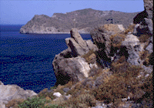
Pesikeshü
Written on Patmos Island about A.D. 95
Thakie kemeyie sorou
Leshü thupie kehou thenie ketsü
Mohor capi
Ketsu kekhu capi
Mhakhu capi
Ukepele pedzü kewa kehou-u
Khrista la vor ketuou
(leshüda puo)
Kechachie kelhou mu vorketuoko
Pesikeshü
70
9
Notes:
Penned by the old Apostle very near the end of his life,
//// John was exiled on the Island of Patmos about 95 A.D. That's where the Lord gave John – and us -- a colossal view into Eternity Future.
//// John glimpses a vision of unequalled grandeur – and puzzlement –– one that has captivated Bible readers ever since its formation. In THE BIBLE…BASICALLY's high-level view of the entire Bible, we can only provide an equally high view of this final Book of Scripture. THE REVELATION is a document of enormous argument regarding its meaning throughout the Church and across the centuries.
//// In this glimpse of Eternity Future, there are six main divisions or scenes in the Revelation that most all Bible readers agree are the main sectors of its enormous canvas. They are…
//// THE LETTERS to the seven churches…
//// THE SEAL JUDGMENTS
//// THE TRUMPET JUDGMENTS
//// THE BOWL JUDGMENTS
//// THE APOSTATE CHURCH and
//// THE RETURN OF CHRIST.

Slide 71



A FABRIC OF THE BIBLE'S CHRONOLOGY
7
NEW HEAVEN, NEW EARTH
EARTHLY REIGN OF CHRIST
4P
3S
MARRIAGE SUPPER OF
THE LAMB
GREAT WHITE THRONE
JUDGMENT
J
THE SECOND COMING
C
J
A
M
J
A
R
S
C
ABRAHAMIC COVENANT
KHRISTA KIJü NU DI KETUO
TEI KESA PUO MU KIJü KESA PUO
KHRISTA VA KENIE VORKETUO-U
LAND COVENANT
TEKUONUO-U KIYA HE
DIENYA THELA-U
DAVIDIC COVENANT
NEW COVENANT
9.65.08.
5
©2006 TBBMI
71
Notes:
Next…you'll remember from “The Fabric of the Bible's Chronology” the final threads that made up the vertical weave of that mental fabric. We identified those vertical threads as
//// THE MARRIAGE SUPPER OF THE LAMB,
//// THE SECOND COMING OF CHRIST,
//// THE EARTHLY REIGN OF CHRIST,
//// THE GREAT WHITE THRONE JUDGMENT, AND
//// THE NEW HEAVEN AND THE NEW EARTH.
Again…most sectors of the Body of Christ recognize these five events, in The Revelation's latter chapters, as significant actions that must be dealt with by the entire Creation at some future time. Slightly expanded, here they are…

Slide 72
Pesikeshü
Written on Patmos Island about A.D. 95
Peshikeshu 19-21 u
teshu pedzu shuya kezha
chakemeyie pengou
(leshüda puo)
Kechachie
kelhou mu vor
ketuoko
Pesikeshü
72
Notes:
FIVE ANCHOR POINTS IN REVELATION from CHAPTERS 19–21.

Slide 73
Tekuonuo-u kiya he
Rev. 19:1-10
Pesikeshü
U sedze kechachie kelhou ngu kevi keshii sede kemeyie
Pesikeshü. 19:9
Süpuo-a a ki, thuliechie,tekuonuou kiyakechühe nu kiepie baketako thejakepfütho, si. Süsie rei puo-a aki, hakoha Ukepenuopfü die kethozo.”
73
Notes:
First…THE MARRIAGE SUPPER OF THE LAMB…Found in Revelation 9:1-10…From verse 9 of that citation: “Then the angel said to me, “Write: 'Blessed are those who are invited to the wedding supper of the Lamb!' And he added, 'These are the true words of God.'”

Slide 74
Tekuonuo-u kiya he
Rev. 19:1-10
The Revelation
U sedze kechachie kelhou ngu kevi keshii sede kemeyie
Jisu Khrista va kenie vor ketuo u
Rev. 19:11-16
Pesikeshü. 19:11 & 16 A atei kokeshü ngu;kier kra puo,mu puo gei kabau üse kedietho mu ketho üya. Tsiu puo-akemezhüü dienya kechü mu terhü kegeiya...
Tsiu puo-a puo pfenei gei mu puo do gei theza. KEDIKO KEDI MU NIEPUKO NIEPUU.
74
Notes:
THE SECOND COMING OF JESUS CHRIST…Revelation 19:11-16…
Verses 11 and 16 read: “I saw heaven standing open and there before me was a white horse, whose rider is called Faithful and True. With justice he judges and makes war...On his robe and on his thigh he has this name written: KING OF KINGS AND LORD OF LORDS.”

Slide 75
Tekuonuo-u kiya he
Rev. 19:1-10
The Revelation
U sedze kechachie kelhou ngu kevi keshii sede kemeyie
Jisu Khrista va kenie vor ketuo u
Rev. 19:11-16
Pesikeshü. 20:6 Themia kehoupuorei rheilakesie therieu nu u ya kenyimia kemesa mu thejakepfü tho.süko mho kesia kenieu puo kekuo jü. Sizomonyü uko-a Ukepenuopfü mu khrista zievoko chü satuo, tsiu chie nyie puo puo ze dituuo.
Khrista kijü nu di ketuo
Rev. 20:4-6
75
Notes:
THE EARTHLY REIGN OF CHRIST…Revelation 20:4-6…Here is verse 6: ”Blessed and holy are those who have part in the first resurrection. The second death has no power over them, but they will be priests of God and of Christ and will reign with him for a thousand years.”

Slide 76
Tekuonuo-u kiya he
Rev. 19:1-10
Pesikeshü
Pesikeshü 20:11-12 Tsiu a-a kediba kekra kezha puo ngu,mu sügei kebau mhingu kinu tei mu kijü tata,tsiu unie ba ngu lalie mota. Siro a-a kesiamia,kechü mu kezhako,kedibau mhodzünu ketha ngu;süsie leshüda huo lhalie;mu leshüda kekrei puo lhalie,süu kerheiprü leshüdau;tsiu kesia ko mhatho kheki sü chü leshüdako nu thupiekezhüko se uko dienya kechü.
Jisu Khrista va kenie vor ketuo u
Rev. 19:11-16
Khrista kijü nu di ketuo
Rev. 20:4-6
Dienya thelau
Rev. 20:11-15
76
Notes:
THE GREAT WHITE THRONE JUDGMENT…Revelation 20:11-15…
Here are verses 11 and 12: “Then I saw a great white throne and him who was seated on it. Earth and sky fled from his presence, and there was no place for them. …And I saw the dead, great and small, standing before the throne, and books were opened. Another book was opened, which is the book of life. The dead were judged according to what they had done as recorded in the books.”

Slide 77
Tekuonuo-u kiya he
Rev. 19:1-10
Pesikeshü
U sedze kechachie kelhou ngu kevi keshii sede kemeyie
Jisu Khrista va kenie vor ketuo u
Rev. 19:11-16
Pesikeshü. 21:1-2 Süsie a-a tei kesa puo mu kijü kesa puo ngu;tei kerieu mu kijü kerieu jüte ru;tsiu dzükezhau rei ba sa mote. Mu a-a rüna nadi kemesa, Jerusalem kesau,yasapfü kerütso dojüse,puo nupfü ki kevo tuoi tegei Ukepenuopfü kinu keker ngu.
Khrista kijü nu di ketuo
Rev. 20:4-6
Dienya thelau
Rev. 20:11-15
Tei kesa puo mu kijü kesa puo
Rev. 21:1-8
77
9.65.08.
Notes:
Finally…THE NEW HEAVEN AND THE NEW EARTH…The Revelation 21:1-8…from verses 1 and 2: “Then I saw a new heaven and a new earth, for the first heaven and the first earth had passed away, and there was no longer any sea…I saw the Holy City, the new Jerusalem, coming down out of heaven from God, prepared as a bride beautifully dressed for her husband.”

Slide 78
Tekuonuo-u kiya he
Rev. 19:1-10
Pesikeshü
Jisu Khrista va kenie vor ketuo u
Rev. 19:11-16
Peshikeshu 19-21 u teshu pedzu shuya kezha chakemeyie pengou
Khrista kijü nu di ketuo
Rev. 20:4-6
Dienya thelau
Rev. 20:11-15
Tei kesa puo mu kijü kesa puo
Rev. 21:1-8
9.65.08.
©2006 TBBMI
78
Notes:
FIVE ANCHOR POINTS IN REVELATION CHAPTERS 19, 20, and 21…a series of apocalyptic events that, for many Bible students, tell of real events coming upon the earth. Are they true.

Slide 79
He who testifies to these things says, “Yes, I am coming soon.” Amen.
“Die hako zhapu chükeshuüu-a ketho zo.”
Amen.
Revelation 22:20
9.65.08.
©2006 TBBMI
79
Notes:
The Bible clearly answers that. The glorious promise of Revelation says this: “He who testifies to these things says, 'Yes, I am coming soon. Amen.' [Rev 22:20] And so we reach the culmination of God's great love letter to man...the grand coda to the whole body of our Scriptures…an astonishing piece of literature that concludes the entire drama of God's Plan among men...begun in 2000 B.C. with old Abraham and those covenant promises…extending through the earthly ministry of His Son, Our Lord and the price he paid for our MISSING THE MARK…giving us that gift of eternal life…while pointing us toward a glorious future time when all is made new, all is sewed up, all is concluded in that time of The New Heaven and The New Earth.

Slide 80
NIEPUU JISU VORLIECIE!
9.65.08.
©2006 TBBMI
80
Notes:
And to that…after this Grand Tour through ALL of Scripture, we can say with great faith and hope: “Come, Lord Jesus!”

Slide 81
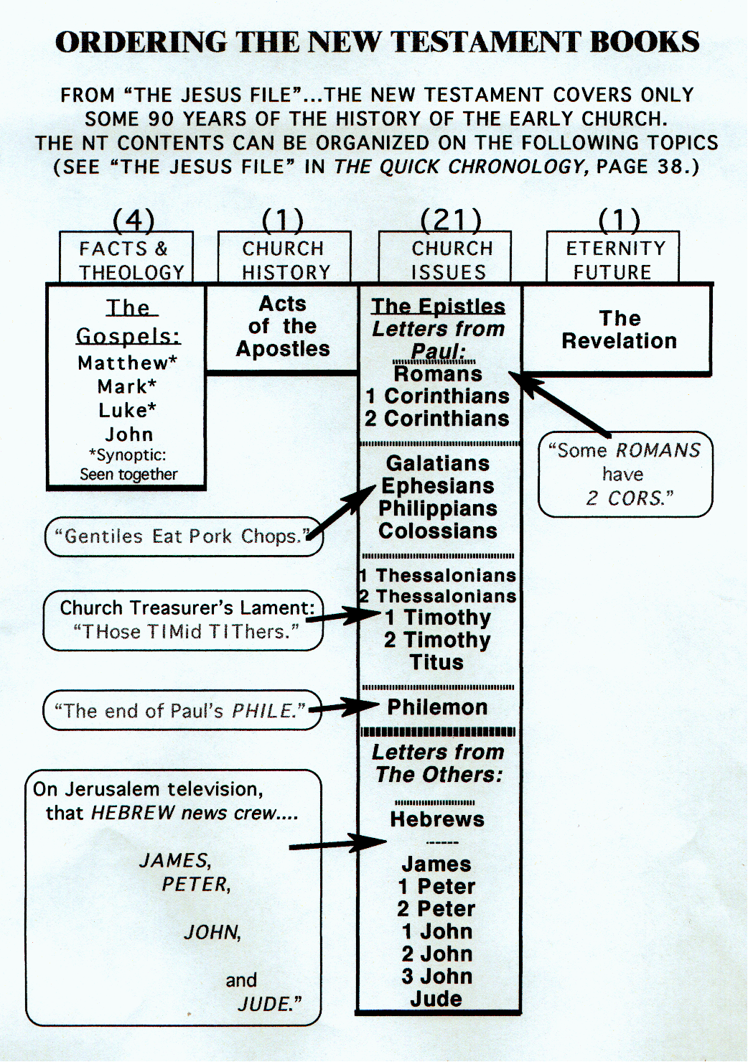
Kephrü kekhruohi #35
9.65.08.
©2006 TBBMI
81
Notes:
Study Help #35 now shows all the 27 books of the New Testament, organized and presented in a way which encourages mental recall and interconnection of events, people and depth of meaning.

Slide 82
Ketholeshu...Sede mvudze
®
“ketholeshu nu leshuda hiesorou ko kesieso”
OT
NT
Kephrü kekhruohi #34 & #35
9.65.08.
©2006 TBBMI
82
Notes:
Side by side…Study Helps 34 and 35…bring it all together. 39 books in the Old…27 books in the New…the entire collection of all we know…or ever need to know about God's relationship to his Creation…from misty prehistory into the unknowable Glory of the New Heavens and the New Earth.

Slide 83
A FABRIC OF THE BIBLE'S CHRONOLOGY
7
TEGEI KESA MU KIJü KESA
EKHRISTA KIJü NU KEDIU
4P
3S
MARRIAGE SUPPER OF
THE LAMB
GREAT WHITE THRONE
JUDGMENT
J
VA KENIE VOR KETUOU
C
J
A
M
J
A
R
S
C
ABRAHAMIC DIETSI DIEKHO
KiJü DIETSI DIEKHO
DAVIDIC DIETSI DIEKHO
DIETSI DIEKHO KESAU
Kephrü kekhruohi #28: THE GRAND SUMMING UP!
83
© 2006 TBBMI
9.65.08.
Notes:
A final summing up…Study Help #28…takes us one last time to the Fabric of the Bible's Chronology…showing that series of foundational Abrahamic Promises…the Land, Seed and Blessing…expanded into the Land Covenant, the Davidic, and the New Covenants. Seen in this entire context, one can clearly see that something is going on here…a program is working out…progressively, step by step, across four millennia.

Slide 84
A FABRIC OF THE BIBLE'S CHRONOLOGY
LET'S GET ON WITH THE JOB AT HAND!
7
NEW HEAVEN, NEW EARTH
EARTHLY REIGN OF CHRIST
4P
3S
MARRIAGE SUPPER OF
THE LAMB
GREAT WHITE THRONE
JUDGMENT
J
THE SECOND COMING
J
JISU KHRISTA
C
A
M
J
A
R
S
C
ABRAHAMIC COVENANT
LAND COVENANT
DAVIDIC COVENANT
NEW COVENANT
84
1
© 2006 TBBMI
9.65.08.
Notes:
Surmounted by the appearance and ministry of Our Lord Jesus Christ. Seen on this canvas of enormous width and depth…it is obvious that each one of us has a personal mission…we have a role to play…we have a job to do. And if THE BIBLE…BASICALLY has any message of consequence, it is this: seen through this compressed, essential view of all of Scripture…recognizing the Great Commission given to us by God's own Son…
//// So let us get on with the job at hand!

Slide 85
CIE KETHOLESHü THELAU NU VOR THATE ... PUO SEDE MVUDZE KEPETHA…
HANU KEDI PUO MHIE ZHüGA?
9.65.08.
©2006 TBBMI
85
Notes:
We are now at the end of THE BIBLE…BASICALLY study and content…and what has happened here?

Slide 86

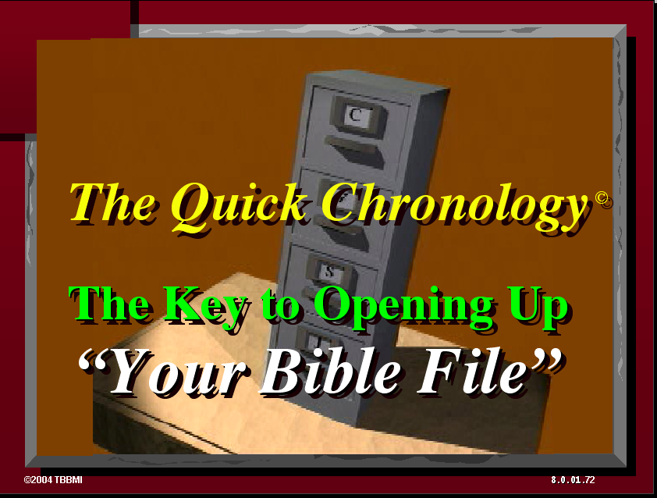
®
The Bible…Basically is ending. Now you have in your thinking…
•An Idea Called “The Bible File”
©2006 TBBMI
9.65.08.
86
Notes:
We mastered that mental key to open “The Bible File”..,. C 7 S J …remembering that central seven with a dash through it: creation, four people – Abraham, Joseph, Moses and Joshua – three societies – anarchy, royalty and captivity – then, silence and finally, Jesus.

Slide 87
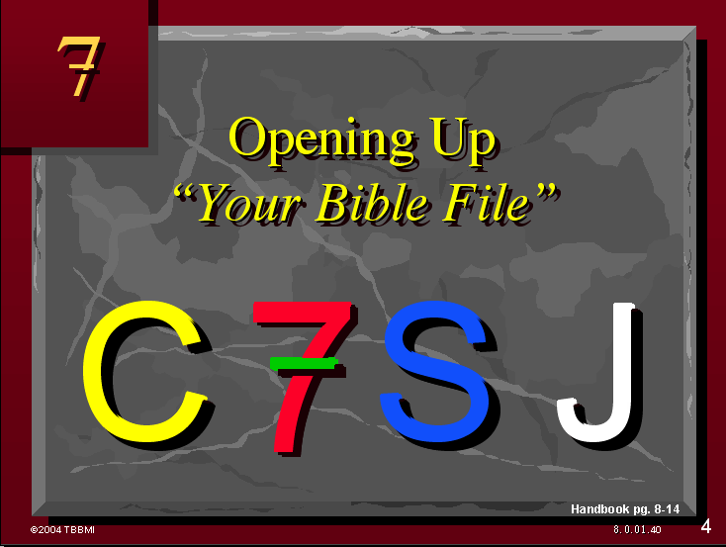
®
The Bible…Basically is ending. Now you have in your thinking…
•An Idea Called “The Bible File”
•The Mental Key to Open “The Bible File”…C 7 S J
9.65.08.
©2006 TBBMI
87
Notes:
We mastered that mental key to open “the bible file”..,. C 7 S J …remembering that central seven with a dash through it: creation, four people – Abraham, Joseph, Moses and Joshua – three societies – anarchy, royalty and captivity – then, silence and finally, Jesus.

Slide 88
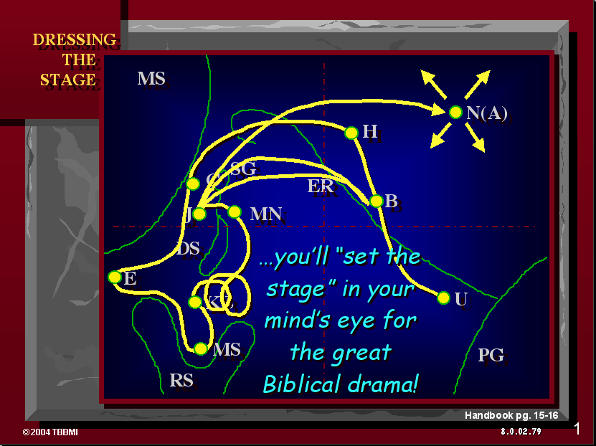
®
The Bible…Basically is ending. Now you have in your thinking…
•An Idea Called “The Bible File”
•The Mental Key to Open “The Bible File”…C 7 S J
•A Mental Map locating Major Biblical Events
9.65.08.
©2006 TBBMI
88
Notes:
We learned to make a simple mental map of the Ancient Near East…one you can draw from out of your own mind.

Slide 89
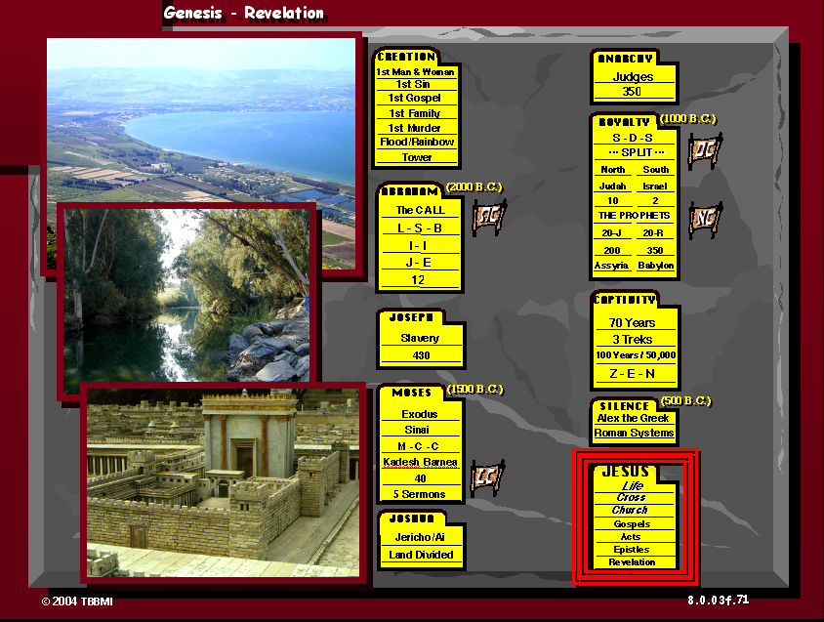
The Bible…Basically is ending. Now you have in your thinking…
®
•An Idea Called “The Bible File”
•The Mental Key to Open “The Bible File”…C 7 S J
•A Mental Map locating Major Biblical Events
•The Bible's “STORY” Core: “The Quick Chronology”
9.65.08.
©2006 TBBMI
89
Notes:
Then that story core of the entire bible…called “the quick chronology.” This is the very heart of the biblical story line…the “what happened and in what order” of God's word

Slide 90
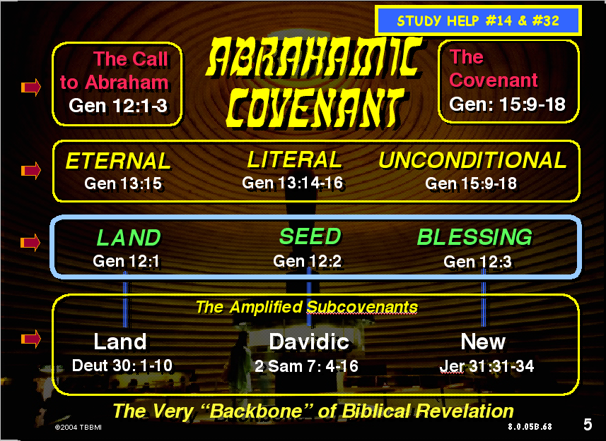
The Bible…Basically is ending. Now you have in your thinking…
®
•An Idea Called “The Bible File”
•The Mental Key to Open “The Bible File”…C 7 S J
•A Mental Map locating Major Biblical Events
•The Bible's “STORY” Core: “The Quick Chronology”
•Abrahamic Foundations of Scripture leading directly to The Ministry of The Lord Jesus Christ
9.65.08.
©2006 TBBMI
90
Notes:
We followed that by answering the question: “why did all this happen?” Reason: because of the four unconditional Old Testament covenant promises of God to man…beginning with the ancient promise to Abraham…called the Abrahamic covenant…then the land covenant of Deuteronomy…the Davidic covenant of Second Samuel…and the new covenant from the writings of Jeremiah…all of these promises from the Old Testament.

Slide 91
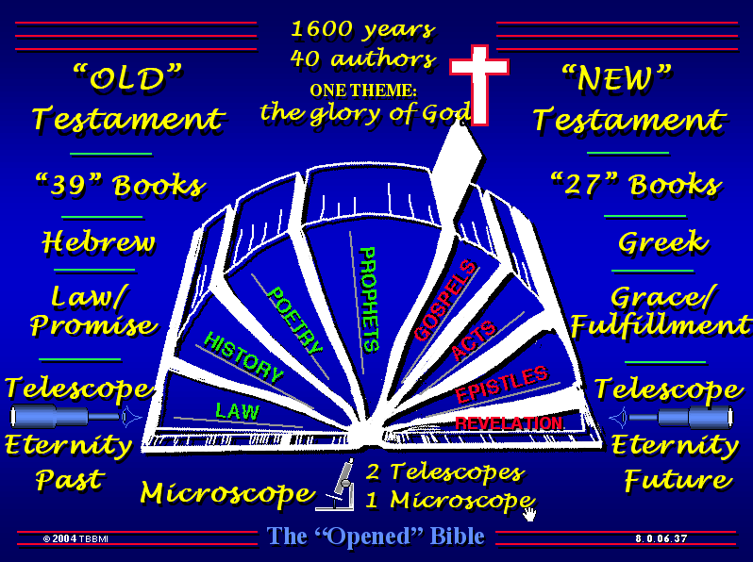
The Bible…Basically is ending. Now you have in your thinking…
®
•An Idea Called “The Bible File”
•The Mental Key to Open “The Bible File”…C 7 S J
•A Mental Map locating Major Biblical Events
•The Bible's “STORY” Core: “The Quick Chronology”
•Abrahamic Foundations of Scripture leading directly to The Ministry of The Lord Jesus Christ
•The Bible's “Architecture” Based on The Story
9.65.08.
©2006 TBBMI
91
Notes:
Then we were in a place to understand just how the bible…as a book to hold in our hands…is organized and arranged…especially those large parallel functional sections of Scripture

Slide 92
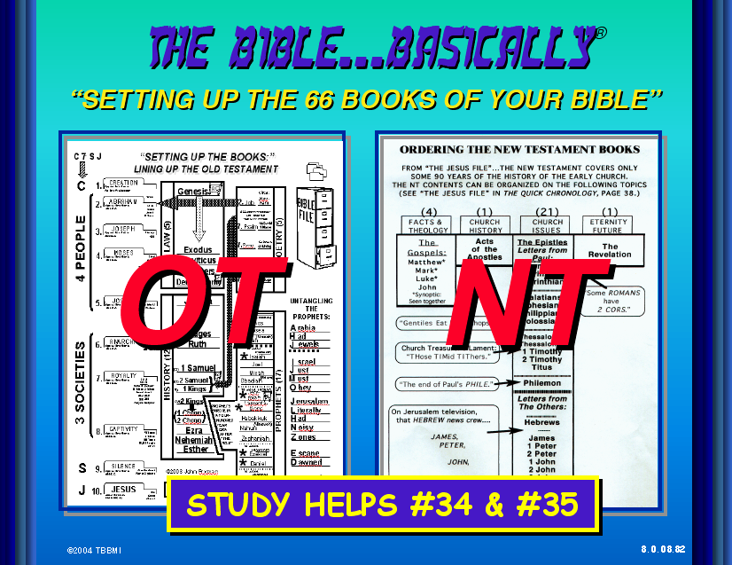
The Bible…Basically is ending. Now you have in your thinking…
®
•An Idea Called “The Bible File”
•The Mental Key to Open “The Bible File”…C 7 S J
•A Mental Map locating Major Biblical Events
•The Bible's “STORY” Core: “The Quick Chronology”
•Abrahamic Foundations of Scripture leading directly to The Ministry of The Lord Jesus Christ
•The Bible's “Architecture” Based on The Story
•The Old and New Testament Books and Themes
9.65.08.
©2006 TBBMI
92
Notes:
…followed by outlining the books of both testaments, seeing clearly how each one is related to the chronological time line from “the quick chronology”…the story core of the Scriptures

Slide 93
The Bible…Basically is ending. Now you have in your thinking…
®
•An Idea Called “The Bible File”
•The Mental Key to Open “The Bible File”…C 7 S J
•A Mental Map locating Major Biblical Events
•The Bible's “STORY” Core: “The Quick Chronology”
•Abrahamic Foundations of Scripture leading directly to The Ministry of The Lord Jesus Christ
•The Bible's “Architecture” Based on The Story
•Ketholeshü keweu mu kesau nu .. Leshüdako mu puo cayieu
9.65.08.
©2006 TBBMI
93
Notes:
All of it coming together to give us a basic outline of the entirety of Scripture…not the details…just a large outline mental map allowing us to mentally manage the bible…to more easily navigate it pages. The result: transformed lives because of the increased meaning of Scripture and the timeless lessons provided by the creator to his created, and the glorious message of the Savior. We now have a synthesized view of Scripture in which God's great plan of the ages is clearly in view.

Slide 94
The Bible…Basically is ending. Now you have in your thinking…
®
“N NYA KESAU PIE N KELEU BU PUOTOU NU KETHOLESHü SEKETUO LA!”
•An Idea Called “The Bible File”
•The Mental Key to Open “The Bible File”…C 7 S J
•A Mental Map locating The Major Biblical Events
•The Bible's “STORY” Core: “The Quick Chronology”
•Abrahamic Foundations of Scripture leading directly to The Ministry of The Lord Jesus Christ
•The Bible's “Architecture” Based on The Story
•The Old and New Testament Books and Themes
94
©2006 TBBMI
9.65.08.
Notes:
This new set of mental tools will allow you – once and for all – to “mentally manage the bible!”

Slide 95
CHIE… PUOTIE KEKHA THELAU NU THATE KEDI
PUO MU?
©2006 TBBMI
9.65.08.
95
1
Notes:
Now it's time to wrap it all up. And here we answer that most basic of all questions:
//// “So what?”

Slide 96
Ketholeshu…
Sede mvudze
©2006 TBBMI
9.65.08.
96

Slide 97


Ketholeshiida…Dietherieko • BibleStudyDownloads.org
Get this presentation for free!
Notes:
The Bible…Basically (bb)

Slide 98
97
©2006 TBBMI
9.65.08.

